Slide 1
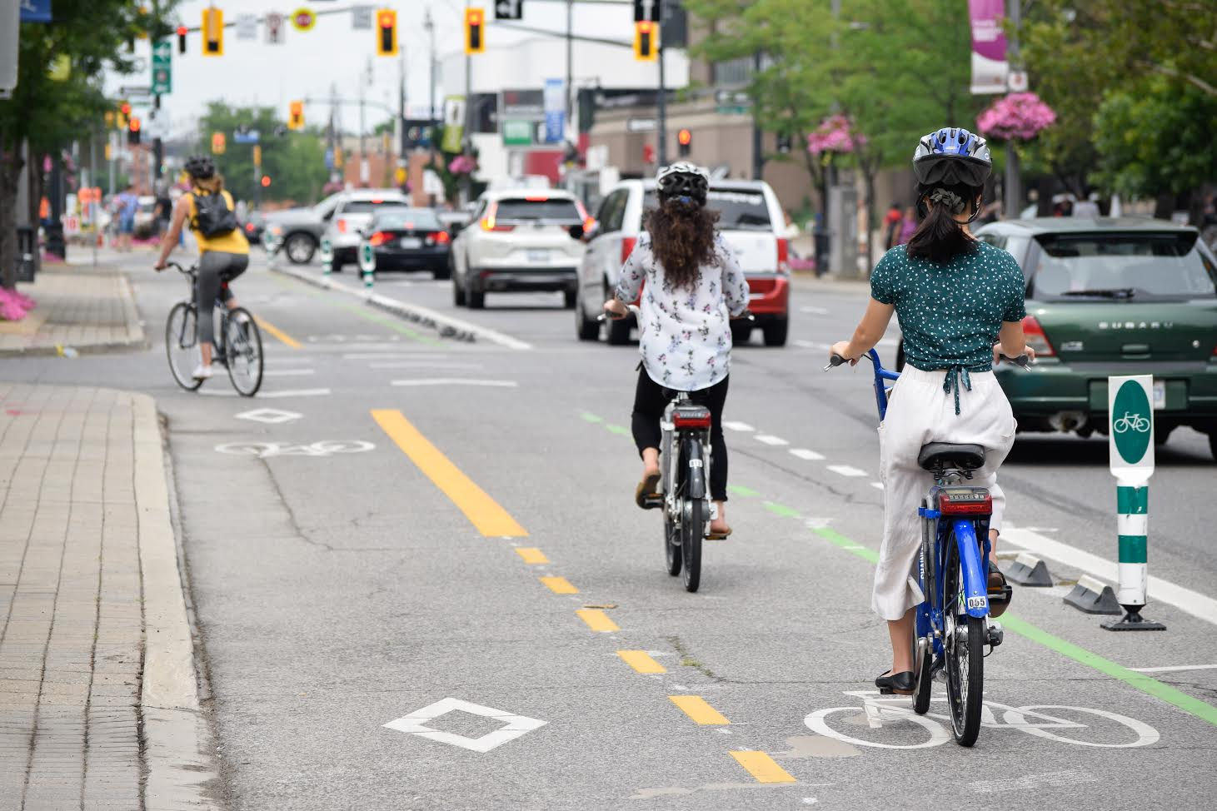
Bike Share 101 RFPs, Contracts and Station Locations
November 9, 2016
Micromobility 101
Getting through Start-up
Peter Topalovic
Program Manager- Sustainable Mobility Programs, City of Hamilton
peter.topalovic@hamilton.ca

Slide 2
Getting Through Start-up and Making it to Launch
Overview
How did we get here?
Decisions and priorities
Micrombility as Transit
Working with the Public and station Locations

Slide 3
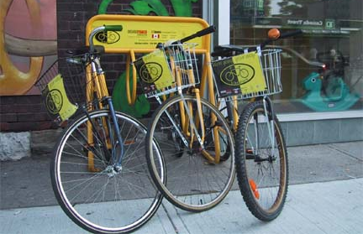
Generation 1-2
Yellow Bike Program
Notes:
History – Gen 1: hippies, US abroad put out free bikes
Gen 2: Amsterdam - thrown in canal
Gen 3: – smart bikes – credit card. Theft and vandalism
Gen 3B: Solar modular, mobile
Currently
Velib popularized. Theft issues.

Slide 4
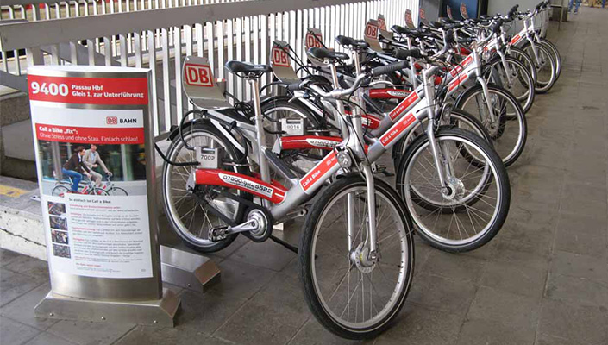
Generation 1-2
Call a Bike
Notes:
History – Gen 1: hippies, US abroad put out free bikes
Gen 2: Amsterdam - thrown in canal
Gen 3: – smart bikes – credit card. Theft and vandalism
Gen 3B: Solar modular, mobile
Currently
Velib popularized. Theft issues.

Slide 5
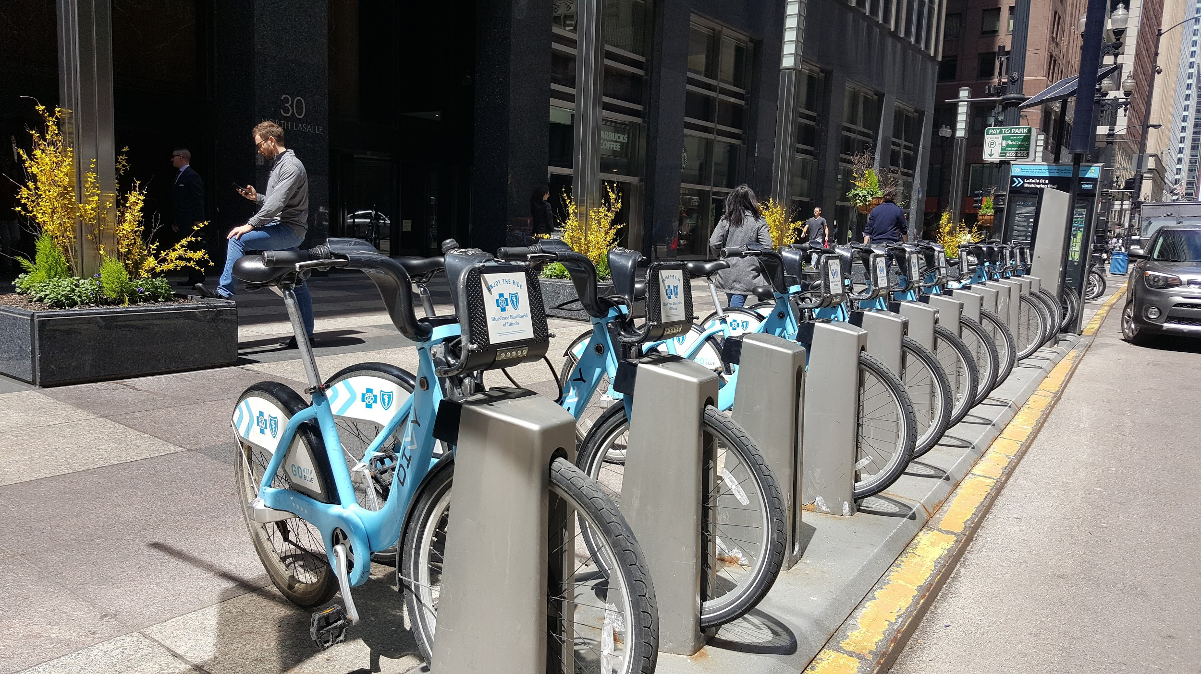
Generation 3

Slide 6
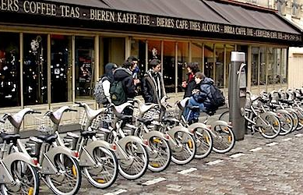
Paris (3 years)
80M bike trips
74,000 daily trips
240,000+ subscribers
6M trips eliminated
Notes:
Paris launched – 54 million trips 2 years, 10,000 bikes, 1000 stations. Largest system at the time.

Slide 7
“But they’re different in Europe”

Slide 8
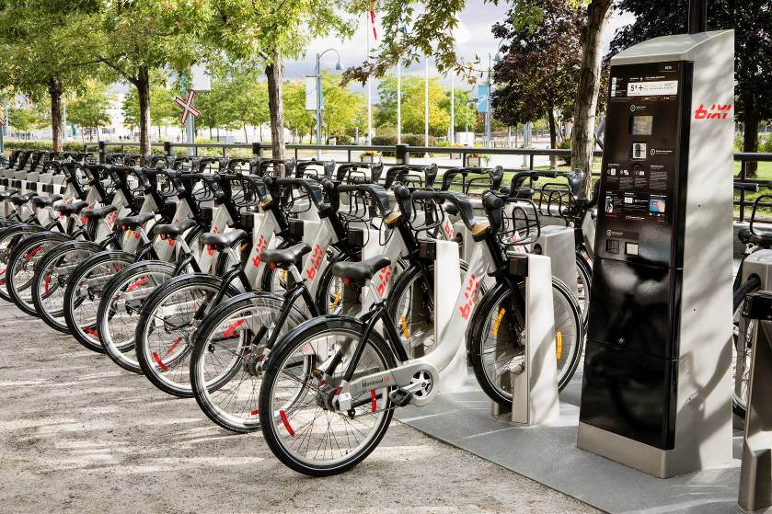
Montreal
5 million trips/year
550 station
5000 + bikes
Notes:
One way trips zipcar on steroids
No reservation
Convenient, hip
Time magazine
Solar, modular, mobile
19th best invention, Time Mag 2008, behind Mars Rover
Convenient Stations every 300 meters , Access bikes with swipe of card , Return bike at any kiosk
Inexpensive Thirty minutes free
Mainstream Users: students, residents, workers, tourists. Designed for everyday trips in skirts and suits

Slide 9
“They’re
French
Canadian, though”

Slide 10
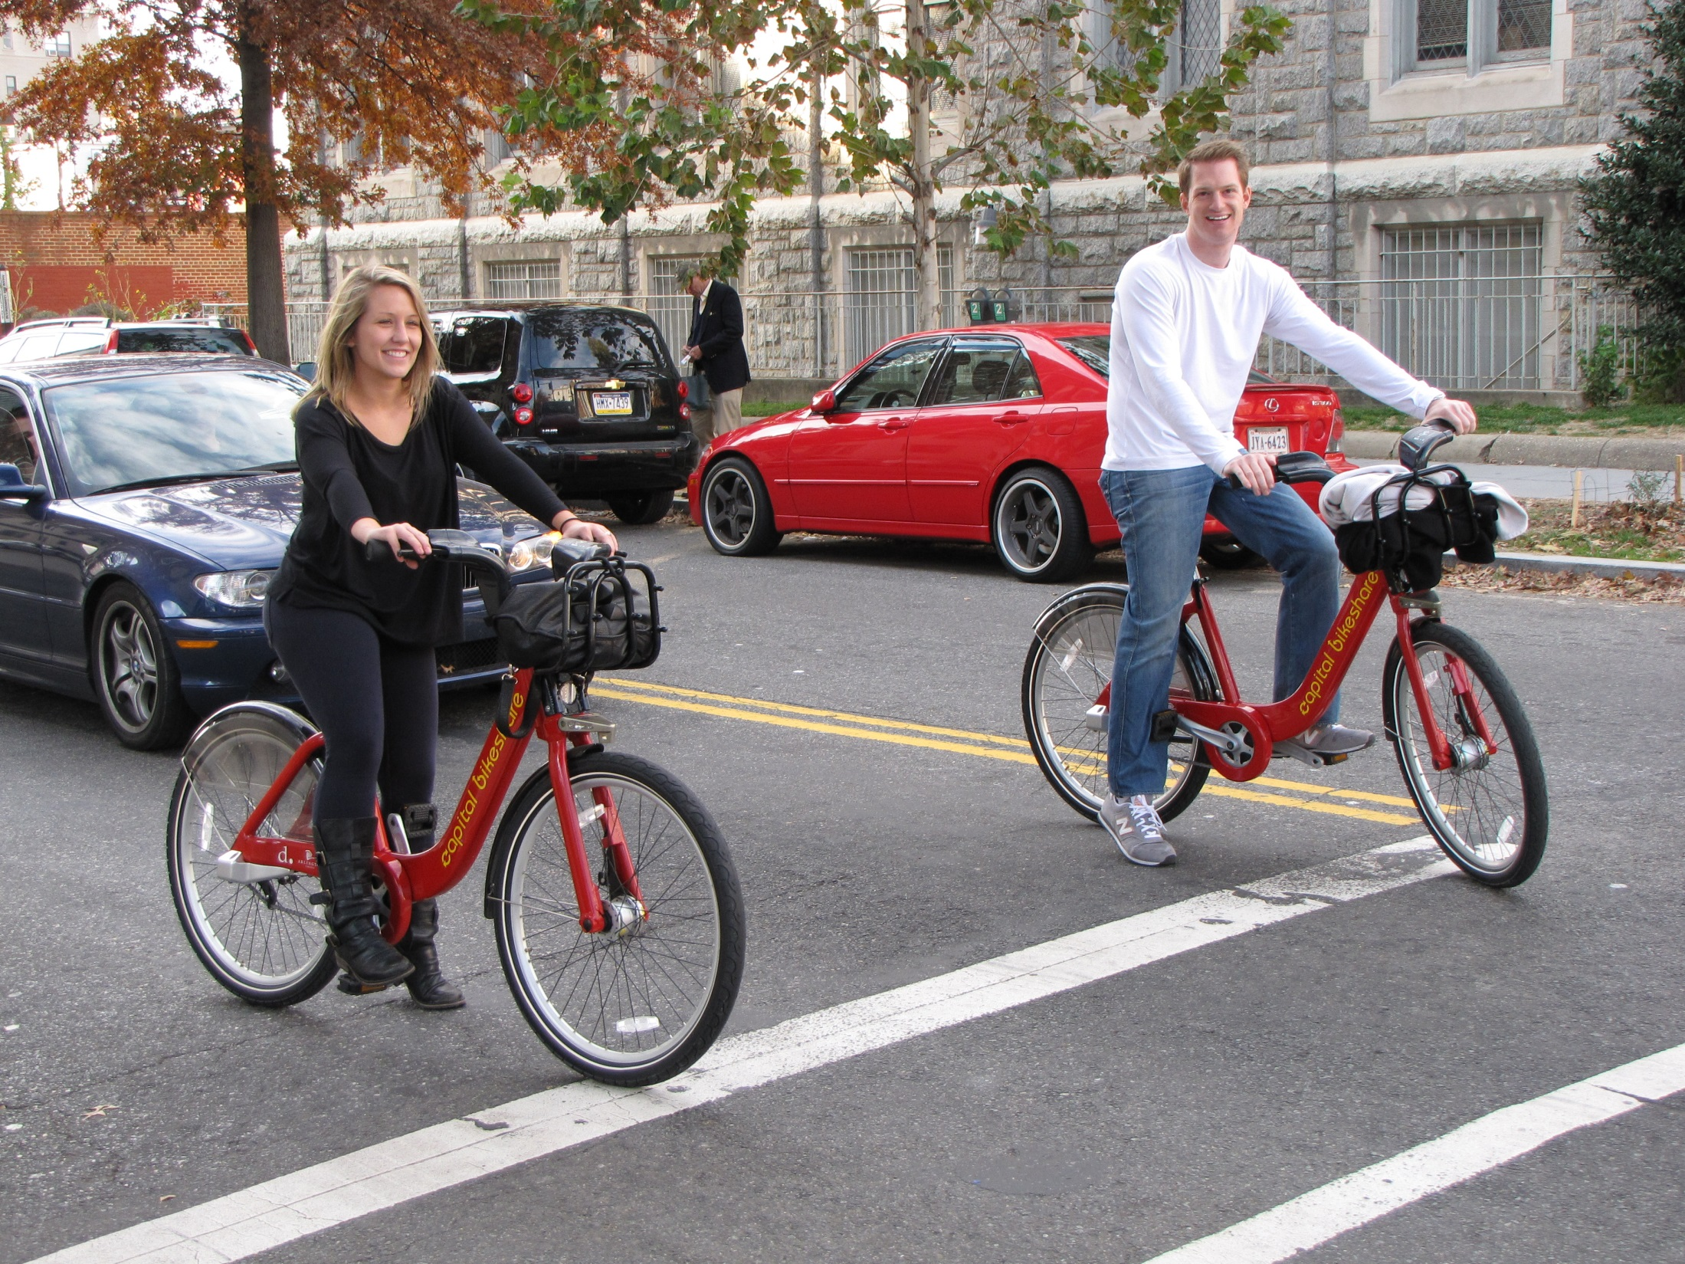
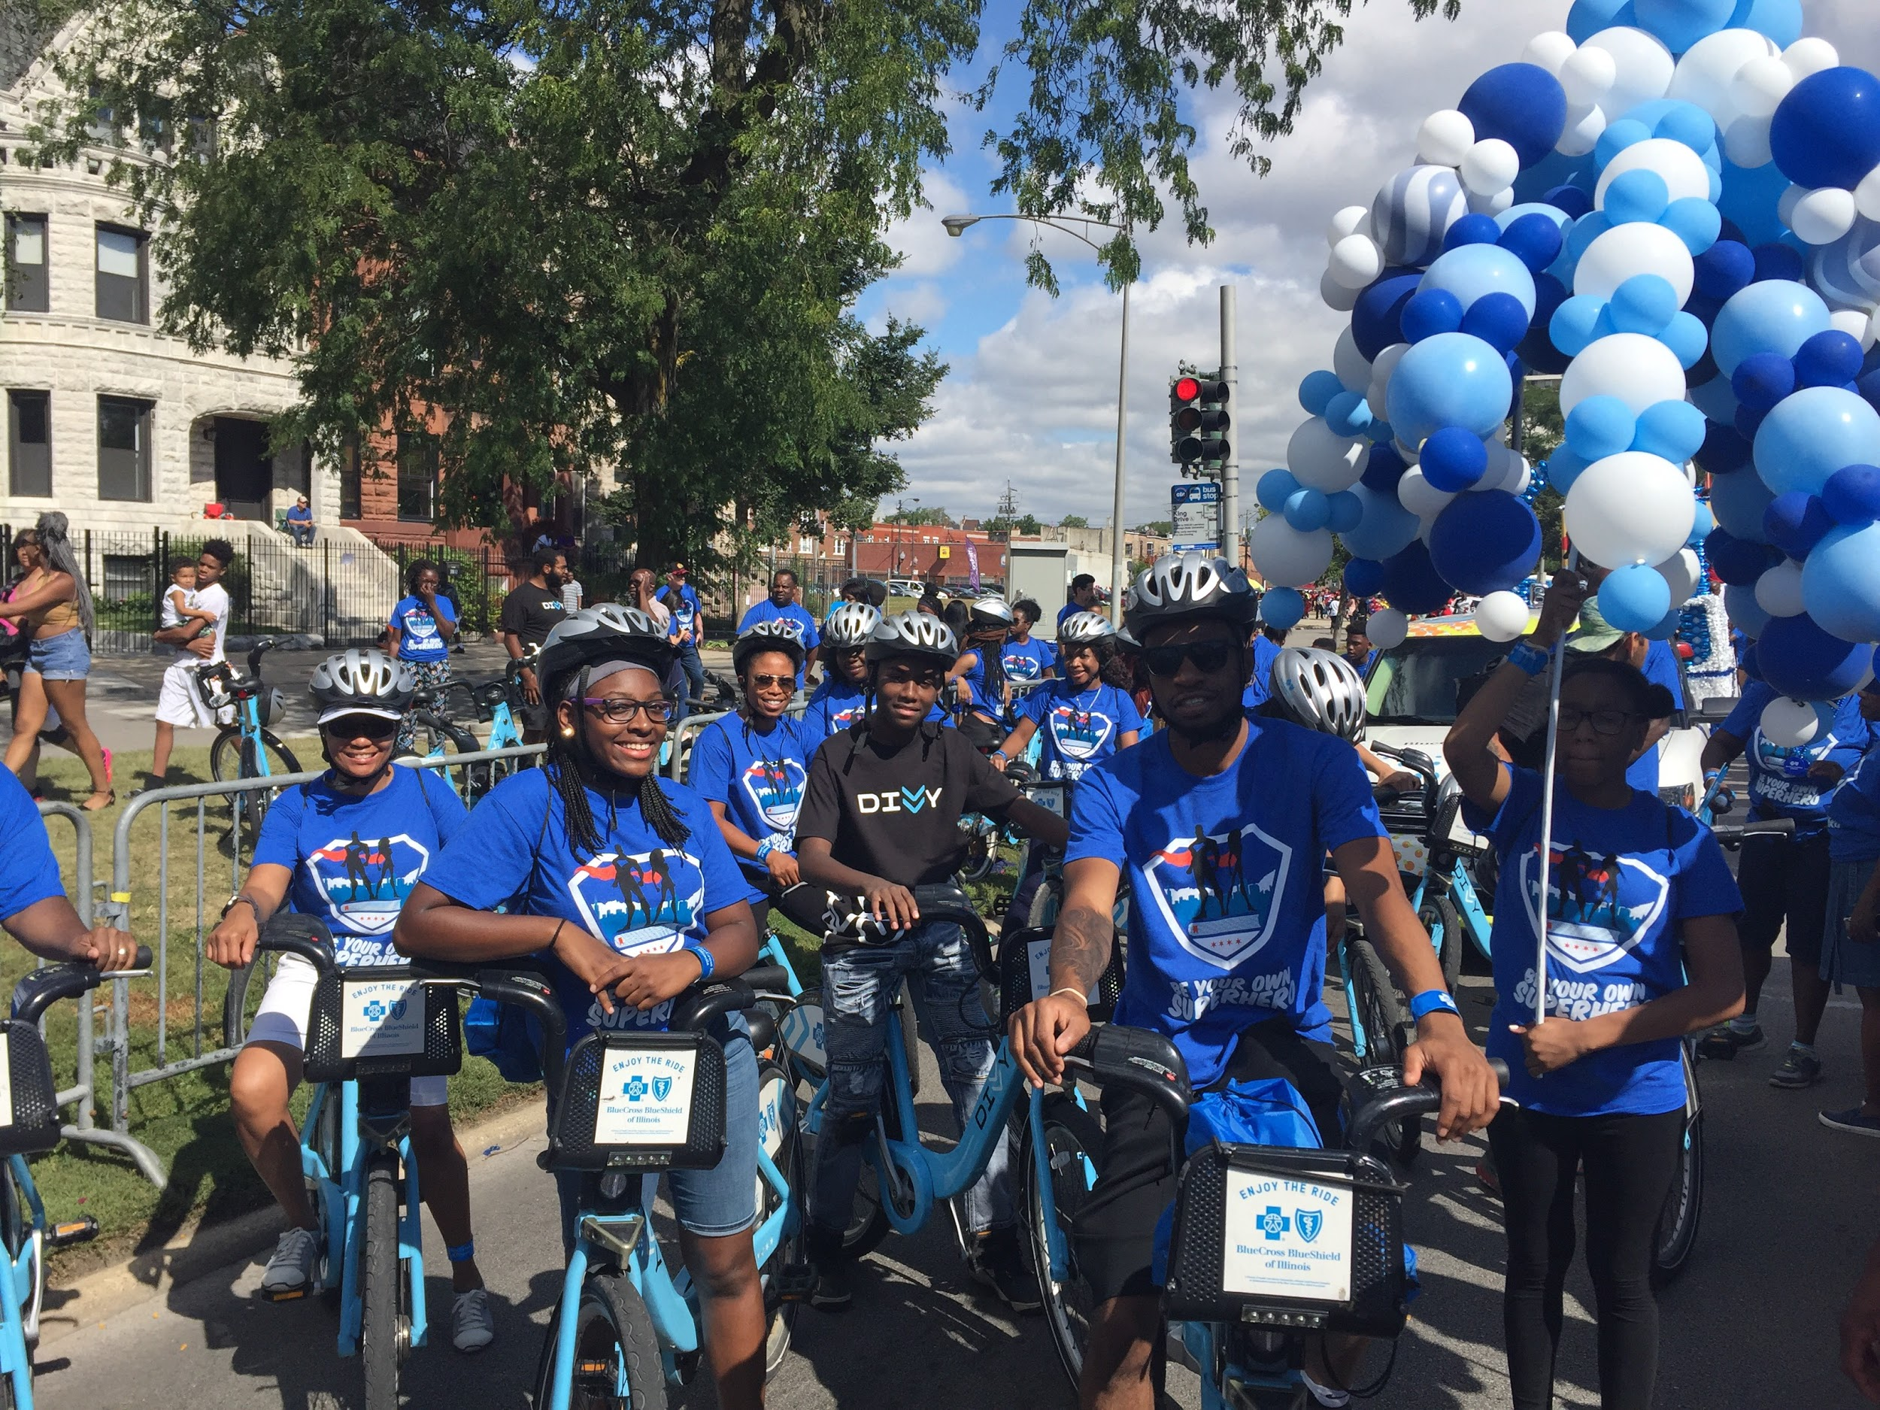
Washington, DC
Chicago, IL

Slide 11
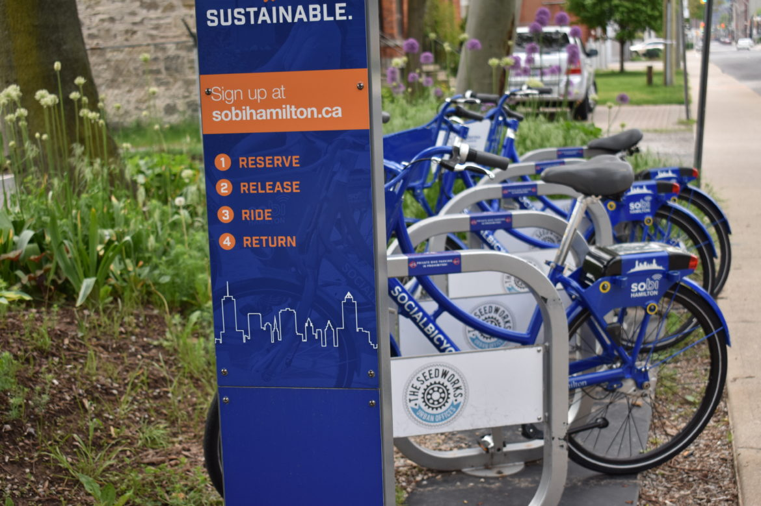
Generation 4
Hamilton, ON

Slide 12
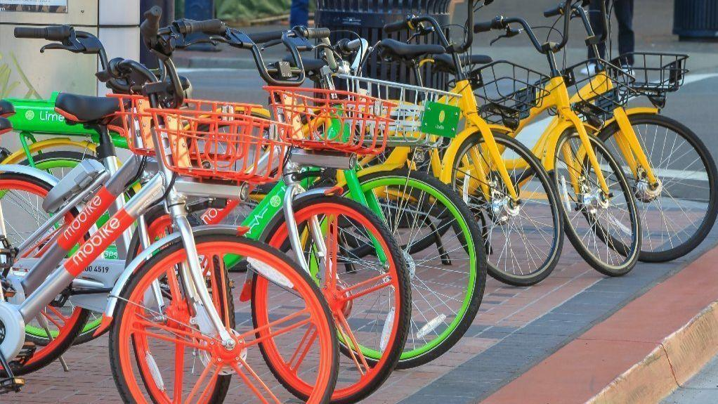
Generation 4

Slide 13
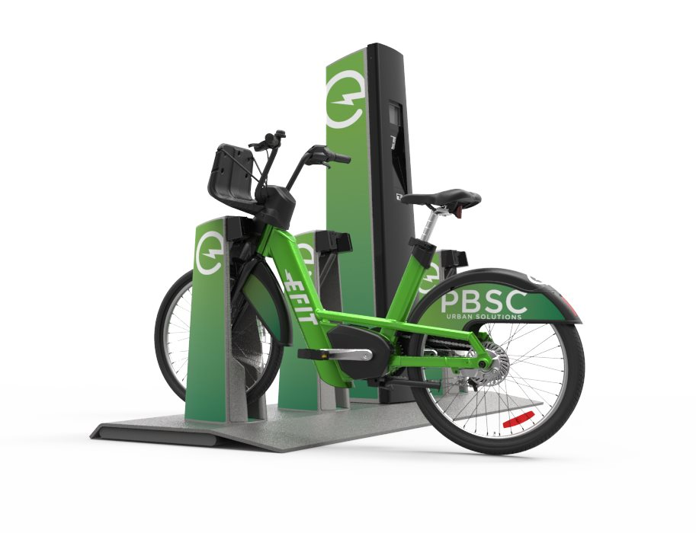
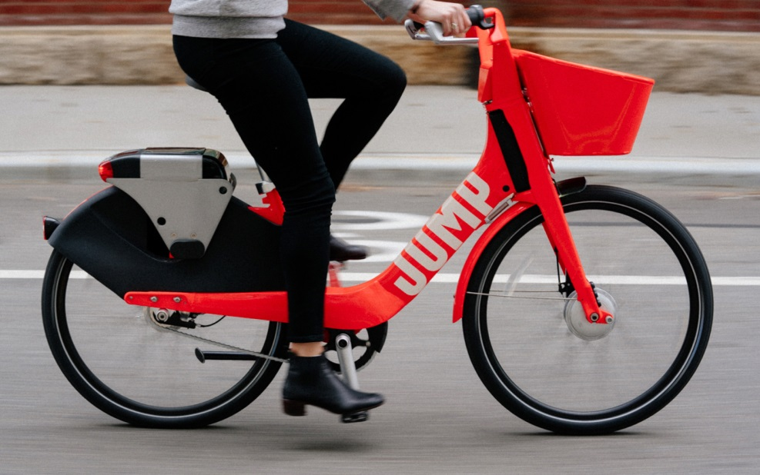
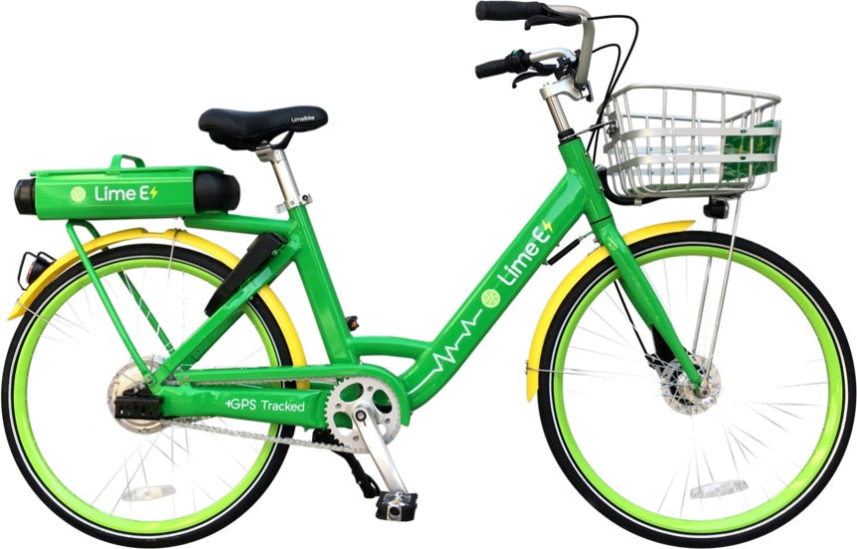
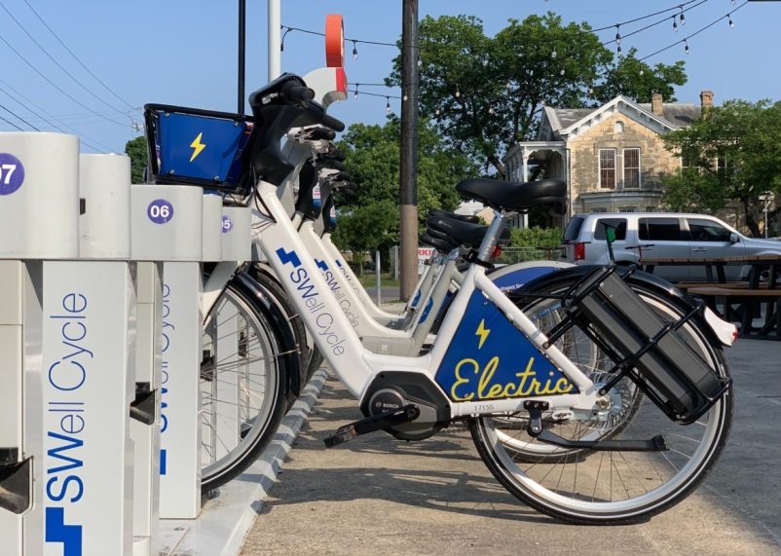
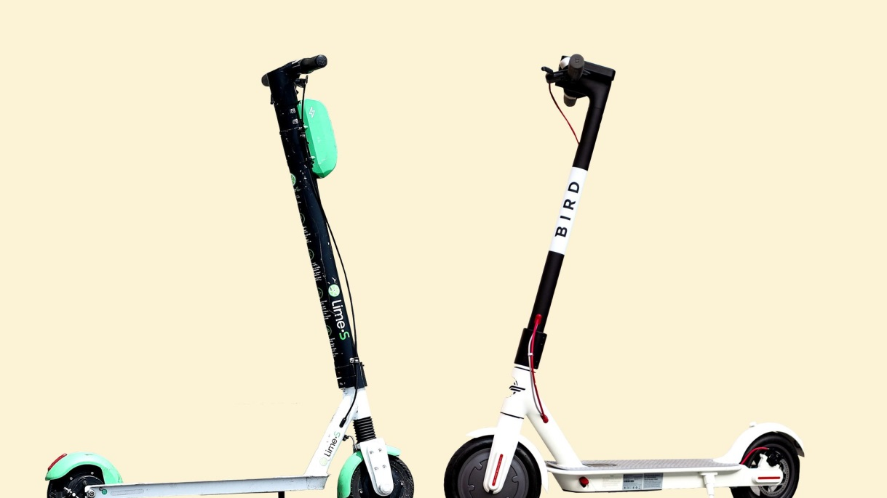
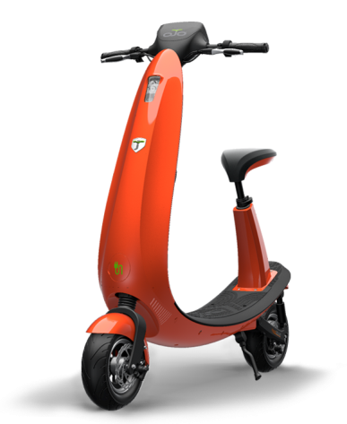
Generation 5?

Slide 14
Decision: Priorities
System Size (Service Area, Station &/or Bike #s)
Transport a substantial number of riders (Metric: Ridership)
Trips & Membership
User Experience (Rebalance Maintenance, Responsive)
Key Considerations (Transit Integration, Environment, Equity, Jobs…)
Financial
Notes:
Denver 7.5 months 102k
MN 12 months 135 k
Bos 4-7 months 140k; 1200 per day
MBTA 1.3M trips per day

Slide 15
Decision: Priorities
Transport a substantial number of riders (Metric: Ridership)
Service
Financial
User Experience
Trips & Members++
System Size++
Extra (Jobs, Equity, Environment, Integration…)
Notes:
Denver 7.5 months 102k
MN 12 months 135 k
Bos 4-7 months 140k; 1200 per day
MBTA 1.3M trips per day

Slide 16
What Kind of City-Operator-Supplier Set-up?
2 Contracts!
RFP/Contract
Eg. Toronto Bike Share
Base capital funding required

Slide 17
What Kind of City-Operator-Supplier Set-up?
Design Build Maintain Operate RFP/Contract
Eg. SoBi Hamilton
Hybrid Model
Non Exclusive Contract/Permit
Eg. Seattle Bikeshare
Operator pays

Slide 18
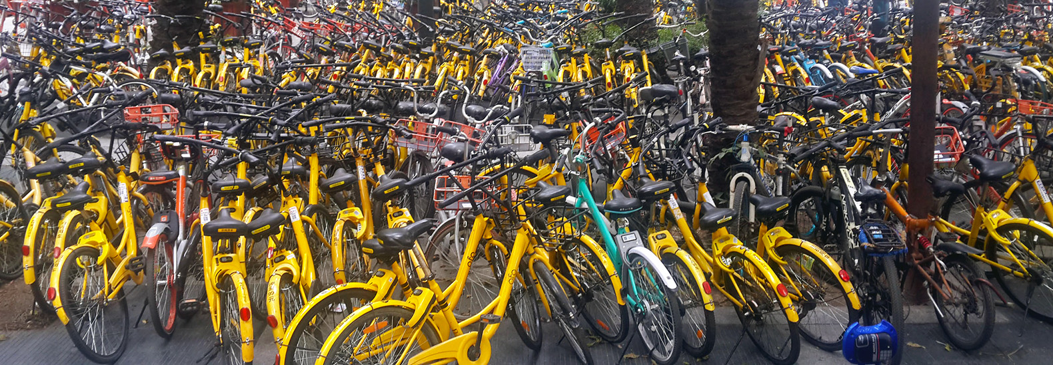
What Kind of City-Operator-Supplier Set-up?
Non Exclusive / No Contract
No fees exchanged but could cost the city money in maintenance

Slide 19
Project Timelines (24 to 32 months)
Research
Feasibility
Fundraising
RFP
Contract
Launch
12+months
4-8 months
4-8 months
4 months
System Design
Site Planning 4-8 Months

Slide 20
Project Timelines (24 to 32 months)
We should really do a feasibility study …

Slide 21
Project Timelines (24 to 32 months)
Business Plan
Market Analysis
Station Locations
Marketing Plan
Financial Plan
Implementation Plan

Slide 22
Project Timelines (24 to 32 months)
Functional Analysis
System Design
Non Exclusive Contract
Launch
12+months
4-8 months
4-8 months
2 months
Design Tweaks
Site Planning 4-8 Months
May require a permit for each location or City Council resolution to approve bikes in all areas of the right of way

Slide 23
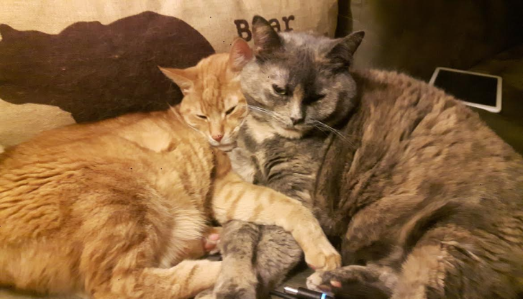
RFPs, Permits, Outcomes & Relationships

Slide 24
Decision: Structure
City Leases Equip
Pays Operator
For–Profit Owns and Operates
Max Control
$ Responsibility
Flat fee, T&M, risk share
~Larger Cities
Some Control
Potential $ Lower Ops Cost
~ Smaller Cities
Reasonable Control
$ Responsibility
Reduced upfront $
~ Smaller Cities
Min Control
No $ Responsibility
~ Very Large Cities
City /Transit Owns
Pay Operator
Non–Profit Owns and Operates
Notes:
Ad and tax model in Europe

Slide 25
Decision: Funding → Sources
Larger Cities
Smaller Cities
Sponsorship
Gov. Grants
Ads
Foundation
User Revenue
Public Funding
Gov. Grants

Slide 26
Decision: Funding → Sources
Sponsorship
How “much” is city willing to sell?
Federal/ State Grants
Easy for launch
Difficult for ops
Ads
Will city allow advertising?
User Revenue
Will depend on density and tourism
Foundation/Private Donor
Do they exist?
City/Transit Funding
Political decision

Slide 27
Decision: Funding → Fundraising
In-House
3rd Party
Pro’s
Mayor
City contacts
Passion
Local Sponsors
Cons
Person dependent
Competing interests
Pro’s
Professional
National Contacts
Ad Sales
Sponsor broker
Cons
Passion/Attention
Additional costs paid to the third party

Slide 28
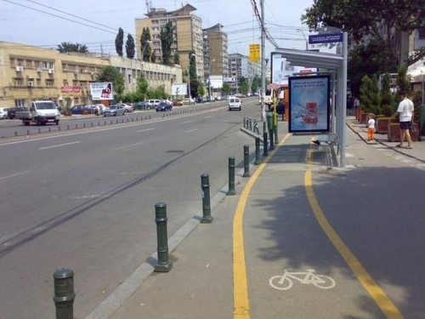
Positioning Bike Share – integrated mobility

Slide 29
Bike Share as Transit and as Taxi

Slide 30
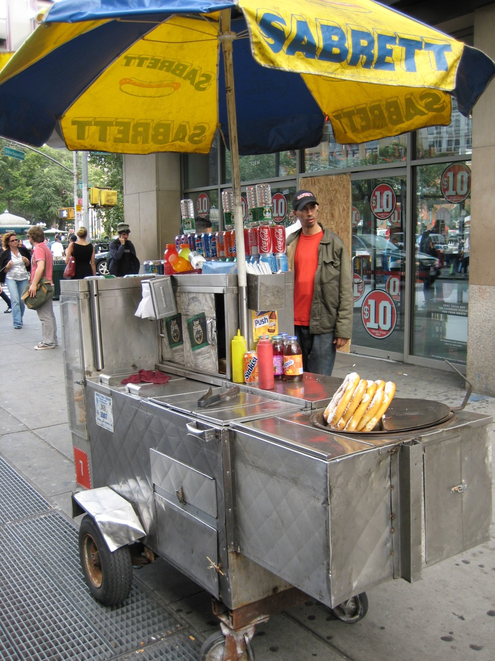
Positioning Bike Share – integrated mobility

Slide 31
Getting Through Start-up
I think bike share is really great as long as its not on my street

Slide 32
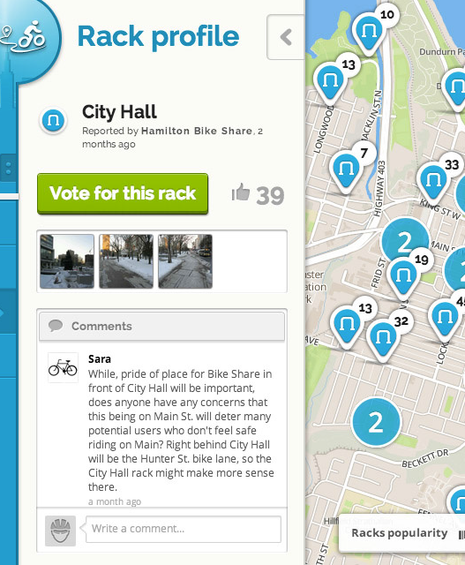
Community engagement is vital

Slide 33
Community engagement is vital

Slide 34
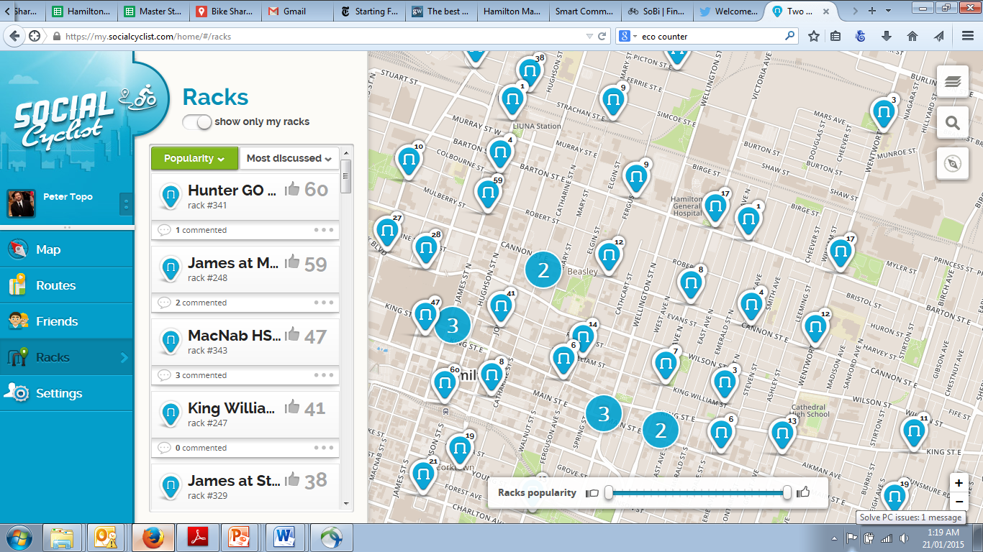
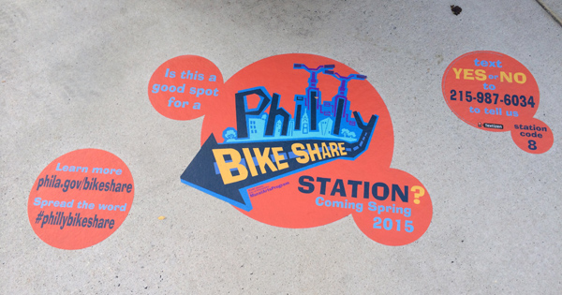
Seize every opportunity for engagement, beyond the engagement period

Slide 35
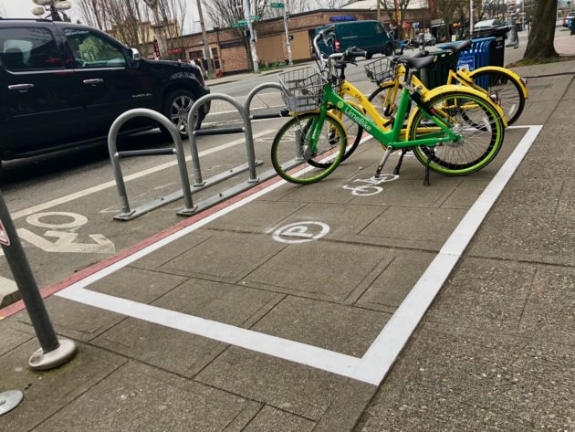
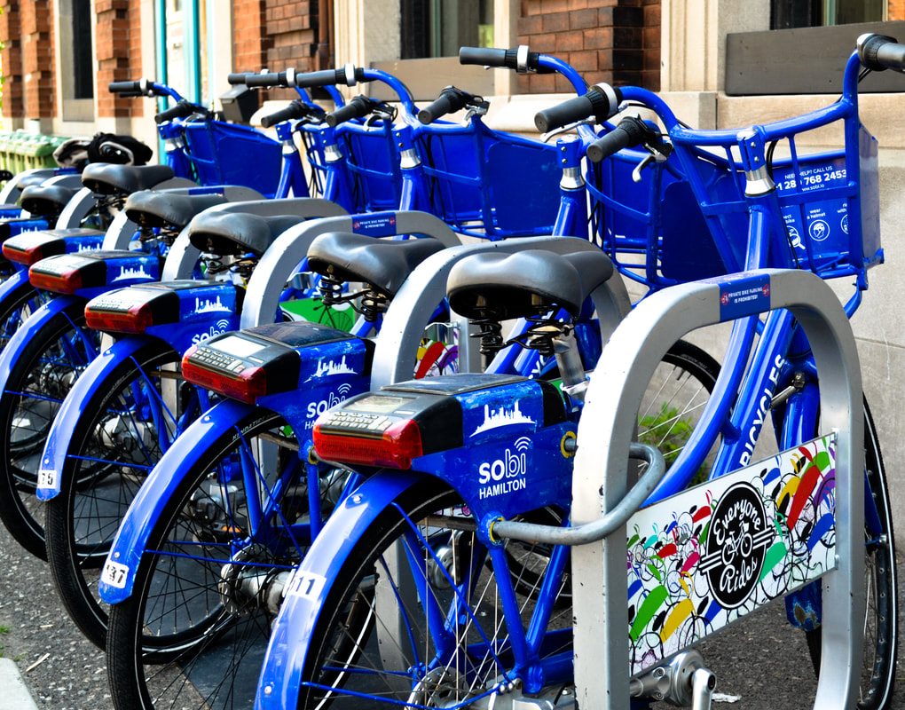
Stations can be anything!

Slide 36
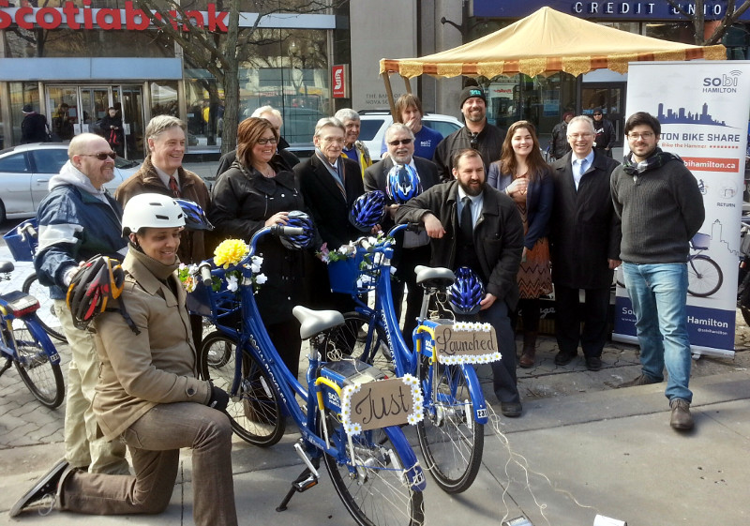
Launch Event

Slide 37
Why isin’t bike share in my neighbourhood? You don’t care about us!

Slide 38
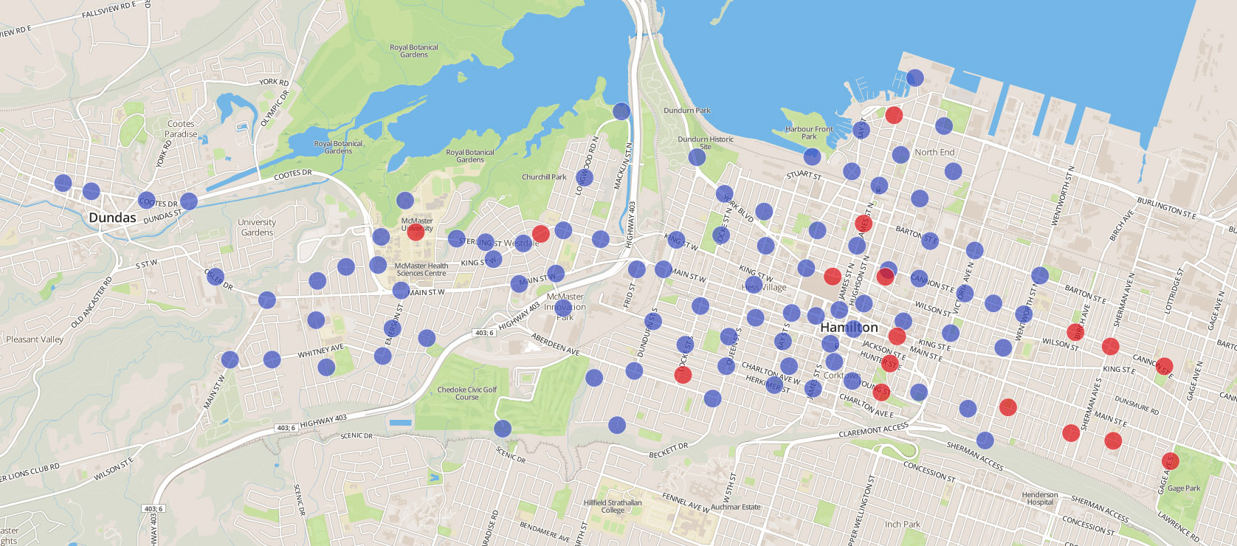
Sure, but who’s going to pay for it?
The need for density and destination!

Slide 39
Data-based Engagement - Planning
Data-based Engagement – Planning and Promoting
Higher order infrastructure attracts more riders and heat maps identify where gaps exist (McMaster data partnership)
McMaster University
King St Bridge Cycle Track
Cannon Cycle Track
Hunter Street cycle track and GO Stn

Slide 40
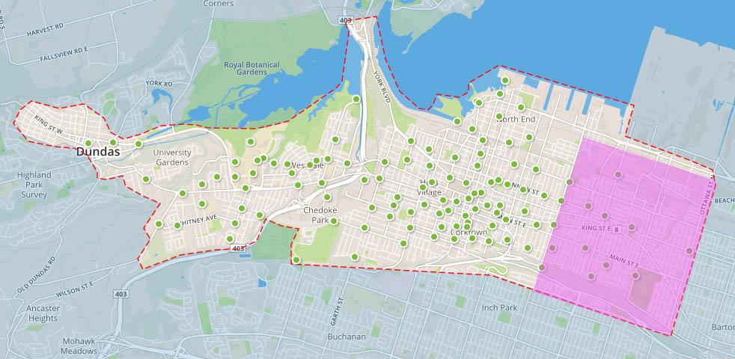
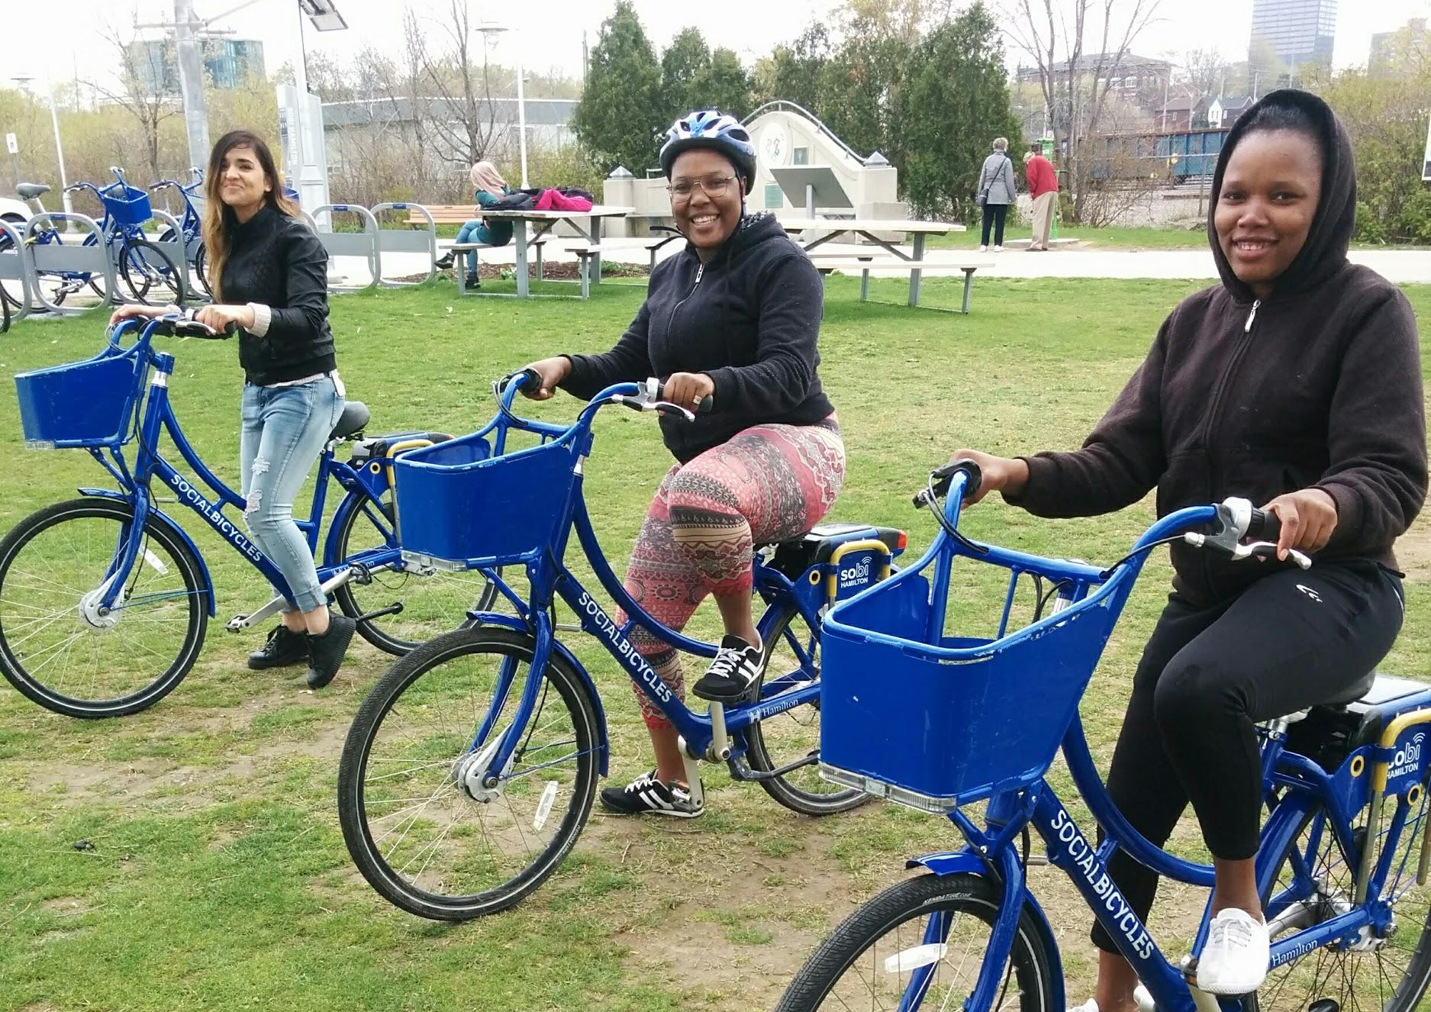
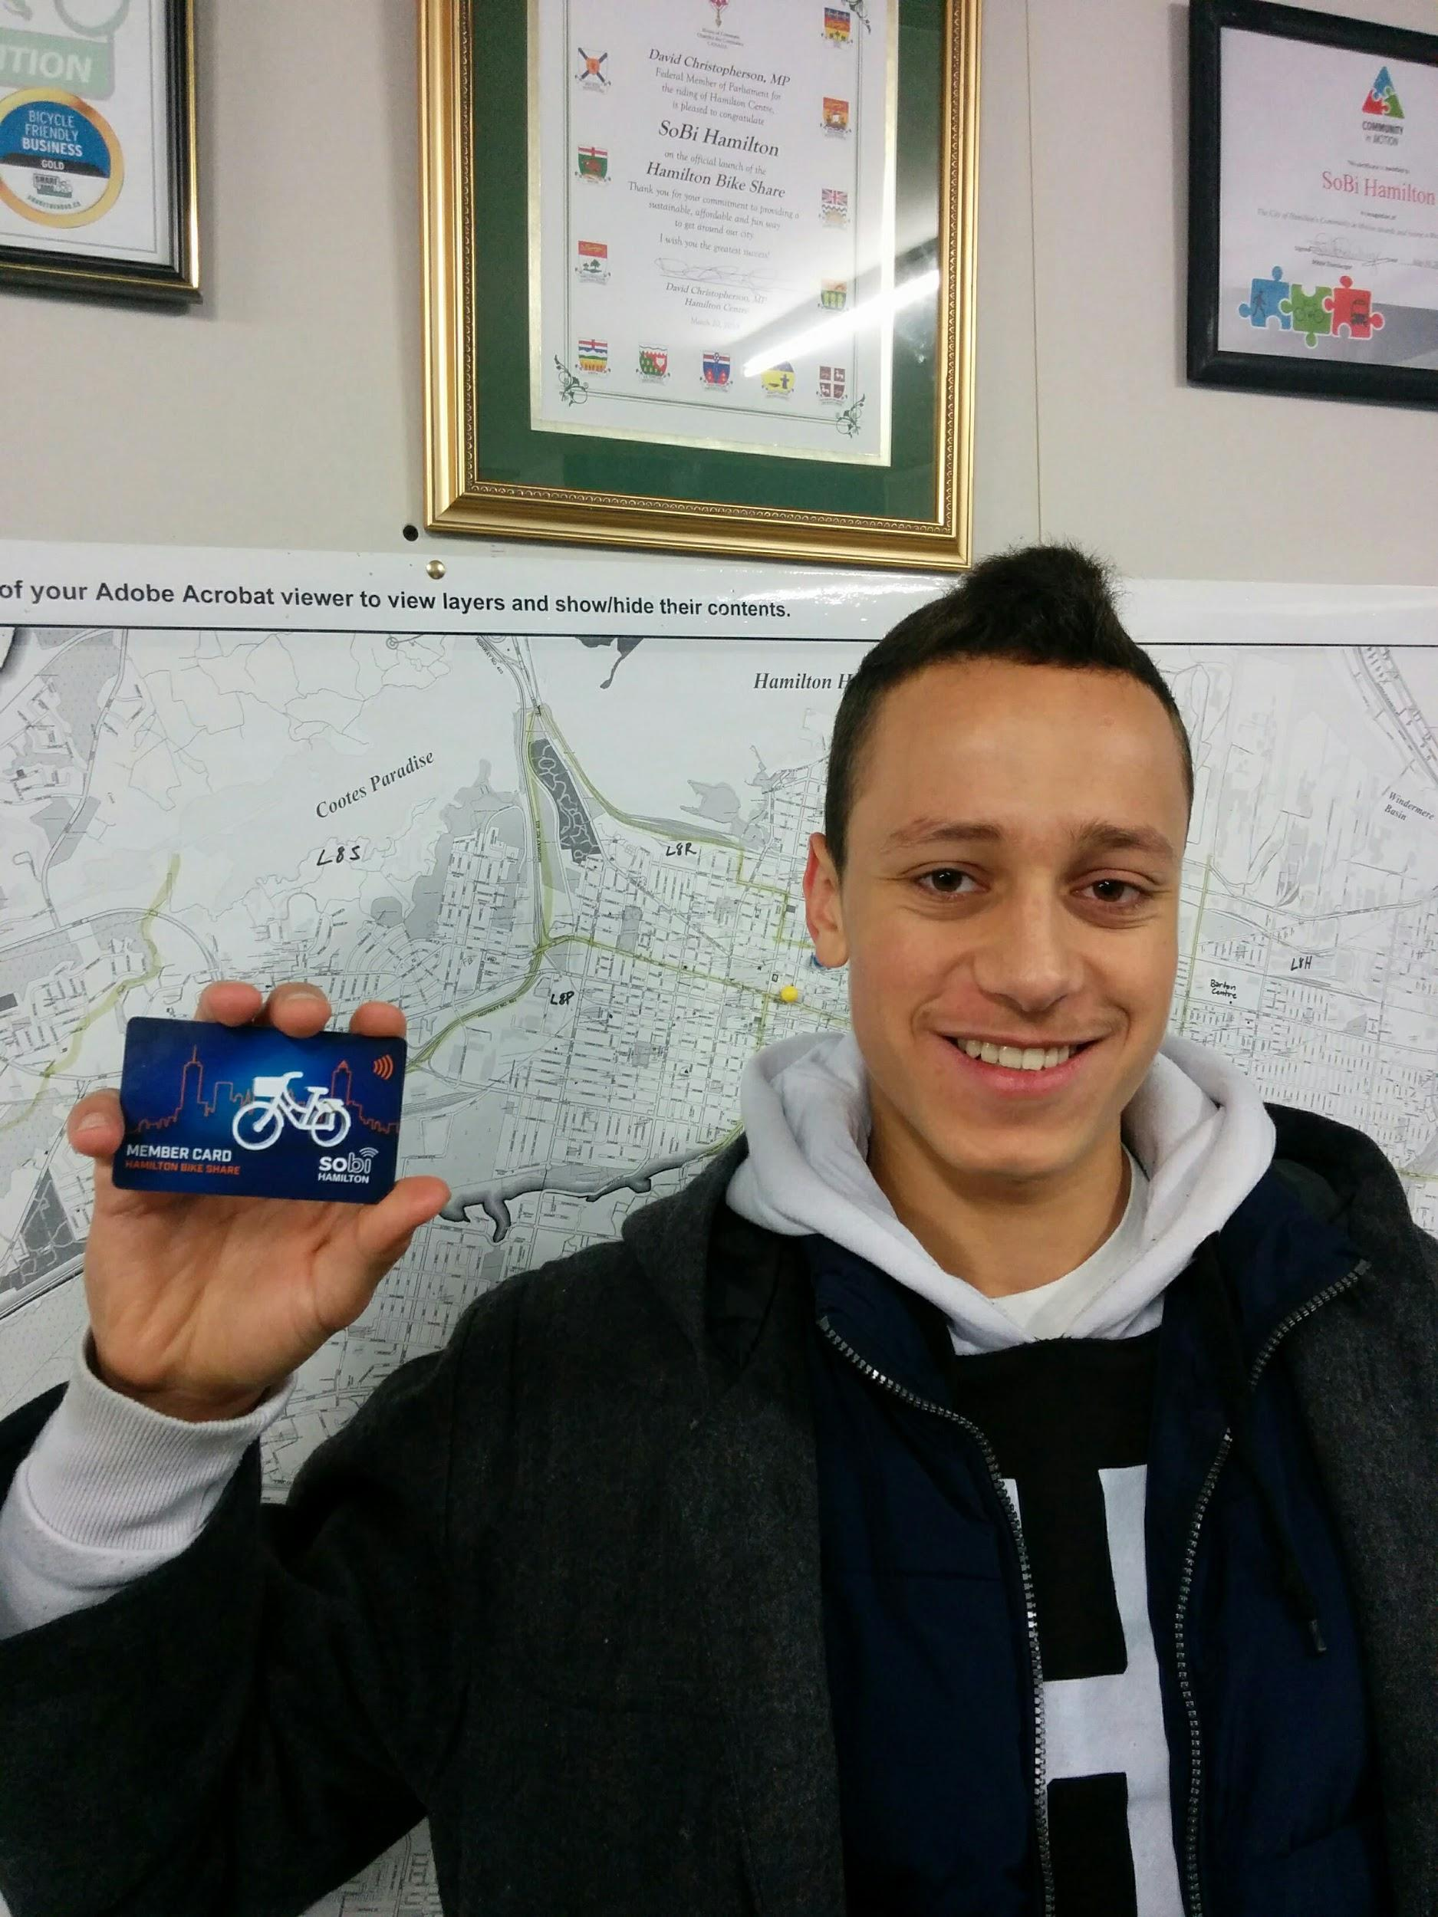
Build Equity into your Design Hamilton’s Everyone Rides Initiative
$600,000 Grant
1000+ Participants
70% changed mode
Over 300 subsidized passes for low income residents and newcomers
100 Cycle Training wokshops and group rides for all participants
Added 15 hubs and 100 bikes in underserved neighborhoods

Slide 41
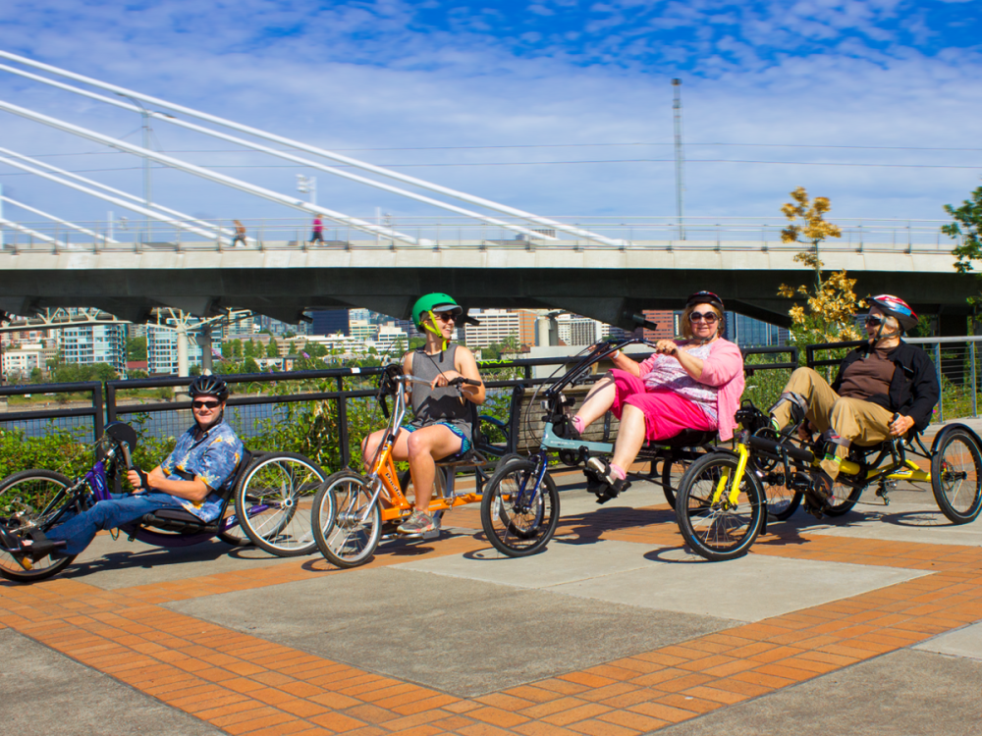
Build Equity into your Design PBOT’s Adaptive Bike Share Program

Slide 42
Getting Through Start-up
What are some of your concerns about:
Start-up
How do you right size your system?
Station Locations
Bikes everywhere!
NIMBYism

Slide 43
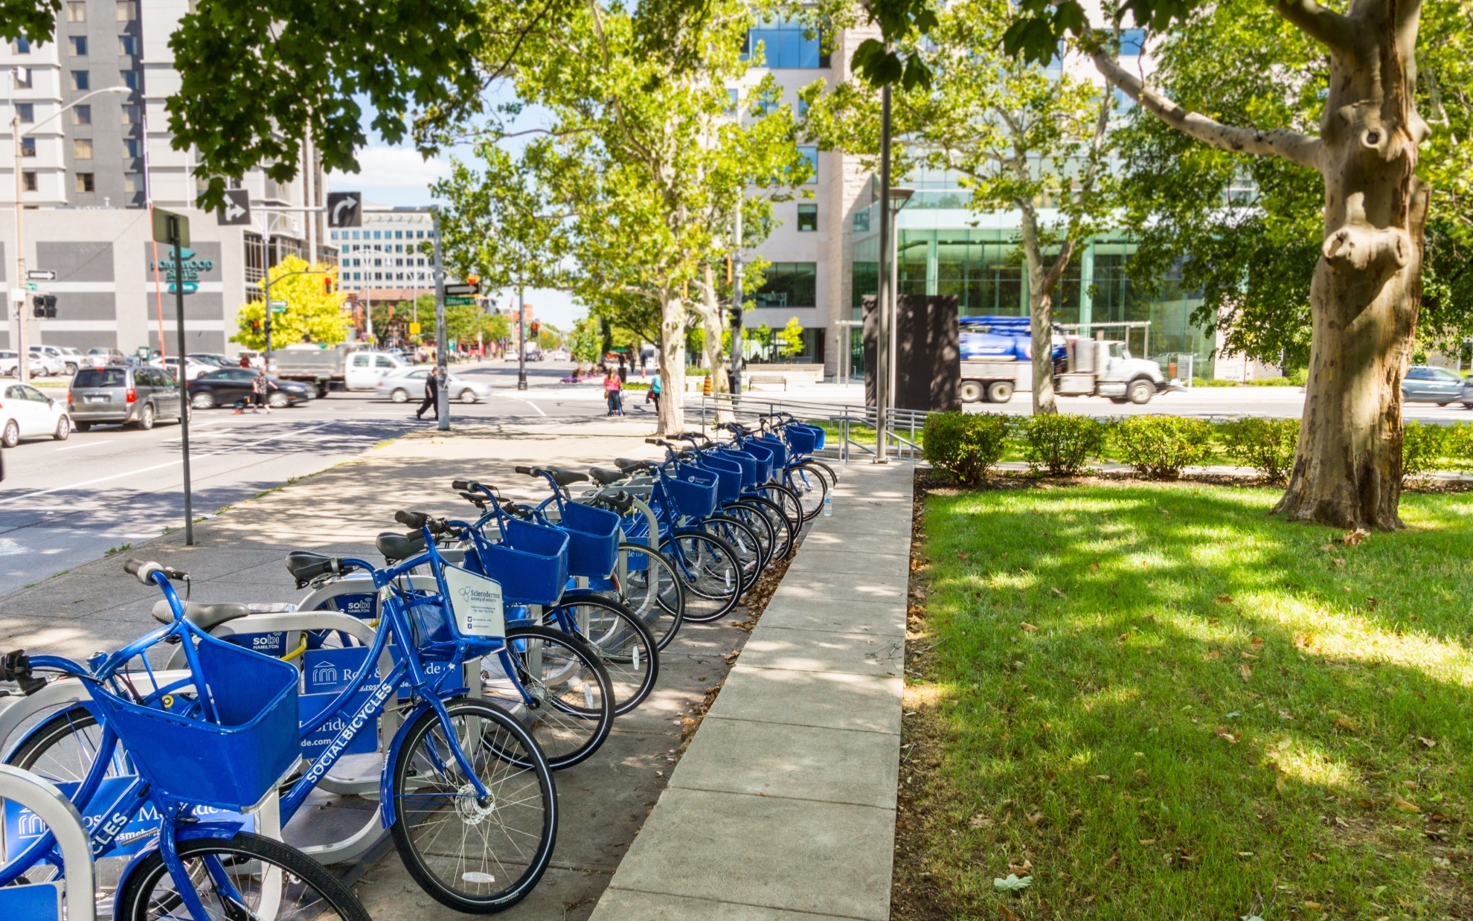
Thank you and Questions?
Peter Topalovic
Program Manager
Sustainable Mobility Programs
+Bike Share
+Smart Commute
City of Hamilton Planning Dept.
Peter.Topalovic@Hamilton.ca
905-546-2424 x.5129

Slide 44
RFP & Contract Considerations
Funding Mechanism Considerations
Who owns the bikes?
Who collects the money?,
Who pays who? Permit? Contract?
How is the grant distributed?
Does the City top up any losses?
Is the operator responsible for losses?
Do you already have a sponsor?
If not, who’s responsible for the sponsor?
Are Development Charges considered for expansion?
Who is responsible for end of life replacement?

Slide 45
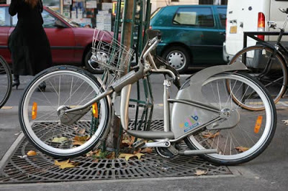
RFP & Contract Considerations
Liability and Indemnity
It depends on the set-up of the relationship between city/government, operator and vendor
Cities are ultimately liable, but risk is low
Be very clear on who replaces bicycles, when and how

Slide 46
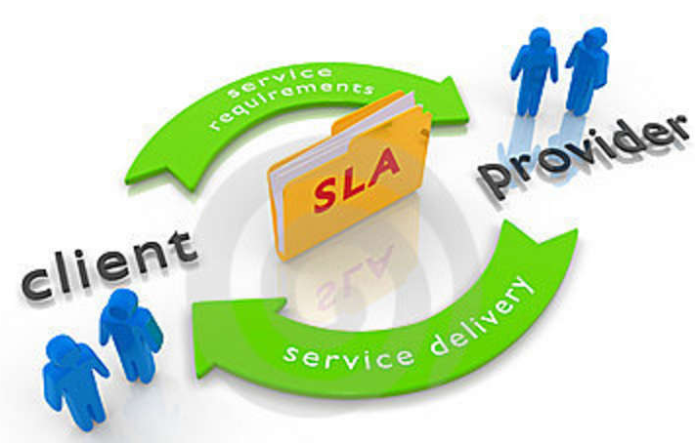
Service Levels Discussion
Service Levels in RFP, Contract or Permit Process
What are the three most important guiding principles for setting service levels?
What elements are you considering or including?
What evaluation metrics will you use?
Maintenance Levels?

Slide 47
Getting Service Levels right
Service Levels!
Need to be reasonable
Incentivize the right Behaviours
Share responsibility for performance issues
Penalty Fees collected should be put into a fund for bike share enhancement
Per-unit Fees should be scaled as system grows
IDIQ – Indefinite Quantity, Indefinite Quality
Limit the amount of bikes that can be deployed?
Force operations into the total bike share service area

Slide 48
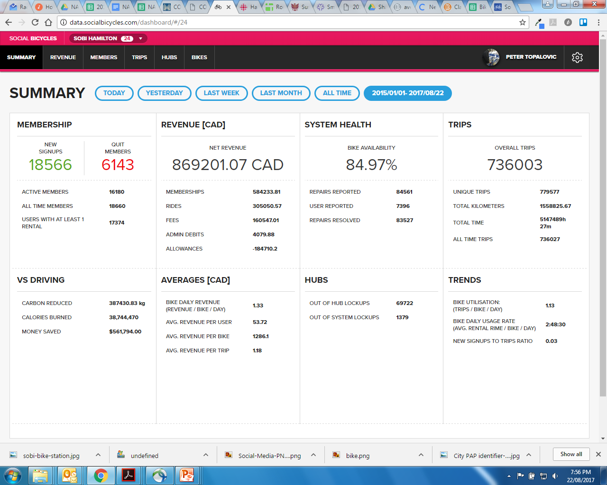
Evaluation Metrics
Develop meaningful metrics
Number of bikes in service & Bike availability
Ridership statistics & Revenue targets

Slide 49
Setting Practical Maintenance Levels

Slide 50
RFPs Contracts and Stations
Recap
Mid-size city systems can work! Don’t de feasibility studies, do a functional analysis!
1
2
Build a system around infrastructure and transit with some predictability
3
Cities should have some control over bike share, but private sector is vital
4
Business planning depends on what type of system you want and who you’re trying to serve

