Slide 1
Bike Share 101 RFPs, Contracts and Station Locations
November 9, 2016
Peter.Topaloivc@Hamilton.ca
City of Hamilton – Transportation

Slide 2
Not Always the Fun Stuff
Request for Proposals
Fair Contracts
Setting realistic service levels
Station Location Issues
Working with the Public
Getting Through Start-up and Making it to Launch!

Slide 3
Not Always the Fun Stuff
Request for Proposals
Fair Contracts
Setting realistic service levels
Station Location Issues
Working with the Public
Getting Through Start-up and Making it to Launch!
Depends on the contract!!
But how?

Slide 4
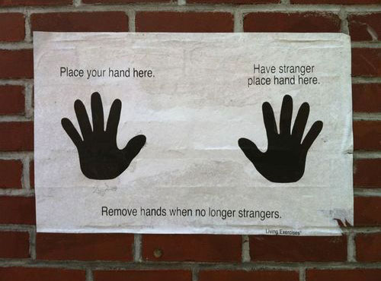
What Kind of City-Operator-Supplier Set-up?

Slide 5
What Kind of City-Operator-Supplier Set-up?

Slide 6
Quick Discussion
What are the major burning questions you have about RFPs and Contracts?
Brainstorm (5 min)
Discuss and select your (5 min):
top 3 questions
top 3 challenges

Slide 7
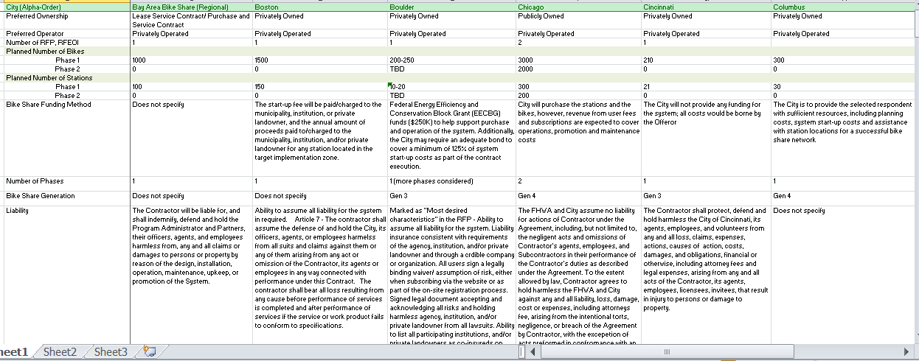
RFP Considerations
⇨ Do your homework
Develop an evaluation matrix for RFPs in similar cities – its okay to do an FOI to get them!

Slide 8
RFP & Contract Considerations
⇨ Prescriptive vs. Open
Do you specify exactly what the system should be down to the exact configuration of the bike or do you
If you are too prescriptive what are you evaluating?
⇨ Choose your evaluation team wisely
Transportation expert/planner, public health rep, transit rep, finance rep, purchasing expert, legal representation

Slide 9
RFP & Contract Considerations
⇨ Give Yourself Time
⇨ To Split or Not to Split??

Slide 10
RFP & Contract Considerations
⇨ Funding Mechanism Considerations
Who collects the money?, who pays who?, how is the grant distributed?, does the City top up any losses?, is the operator responsible? Do you already have a sponsor? If not, who’s responsible for the sponsor? Are Development Charges considered for expansion? Who is responsible for end of life replacement?

Slide 11
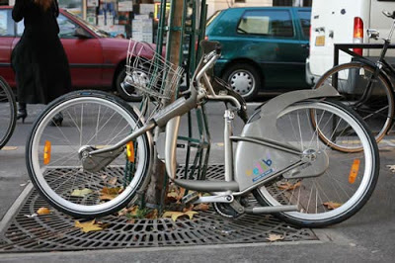
RFP & Contract Considerations
⇨ Liability and Indemnity
It also depends on the set-up of the relationship between city/government, operator and vendor
Cities are ultimately liable, but risk is low
Be very clear on who replaces bicycles, when and how

Slide 12
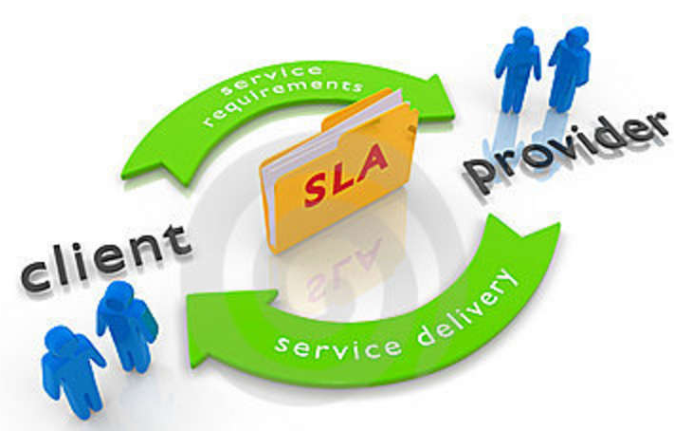
RFP & Contract Considerations
⇨ Service Levels - Discussion
What are the three most important guiding principles for setting service levels?
What elements are you considering or including?
What evaluation metrics will you use?
Maintenance Levels?

Slide 13
RFP & Contract Considerations
⇨ Service Levels!
Need to be reasonable
Incentivize the right Behaviours
Share responsibility for performance issues
Penalty Fees collected should be put into a fund for bike share replacement
Per-unit Fees should be scaled as system grows
IDIQ – Indefinite Quantity, Indefinitely Quality

Slide 14
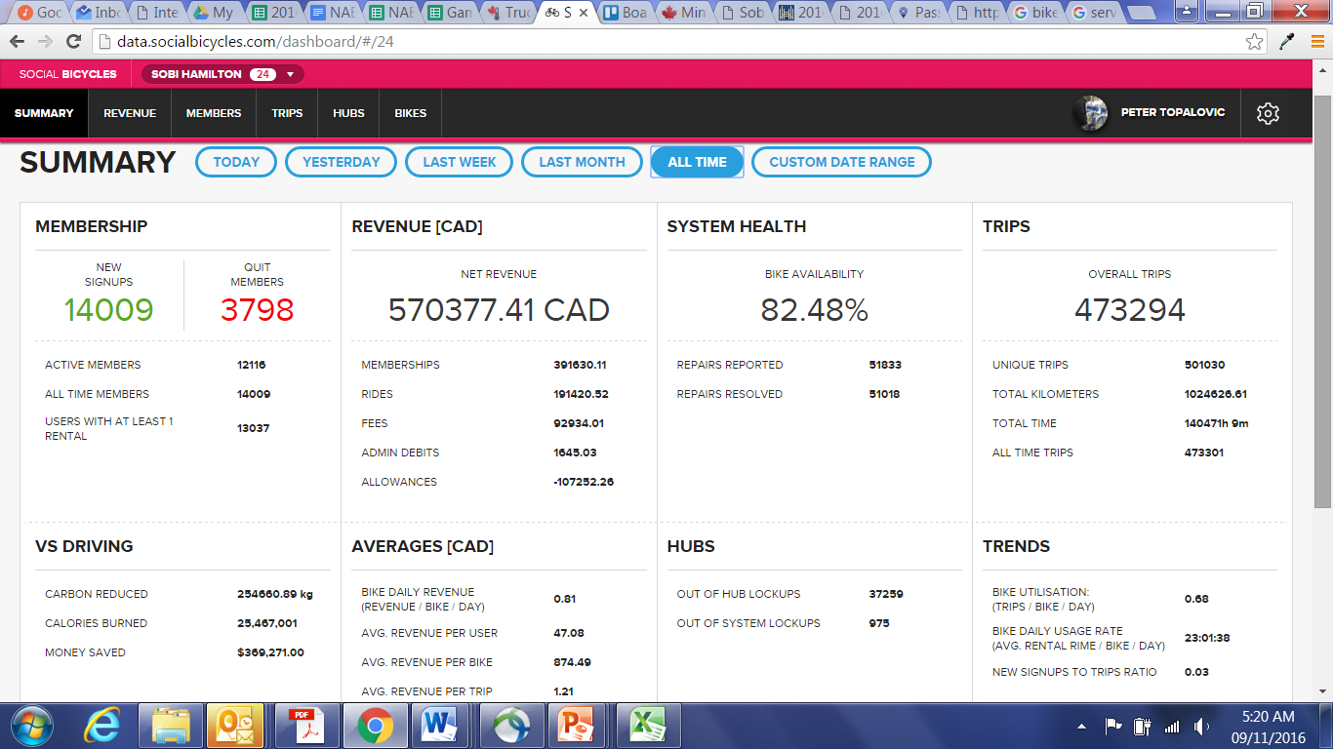
RFP & Contract Considerations
⇨ Develop Key Evaluation Metrics
Number of bikes in service & Bike availability at stations
Ridership statistics & Revenue targets

Slide 15
RFP & Contract Considerations
⇨ Develop Key Maintenance Measures

Slide 16
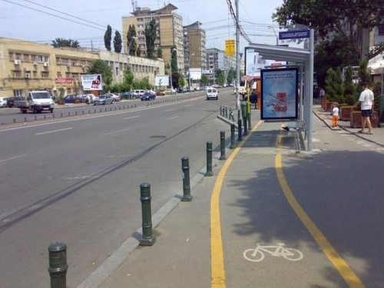
Positioning Bike Share – integrated mobility

Slide 17
Bike Share as Transit and as Taxi

Slide 18
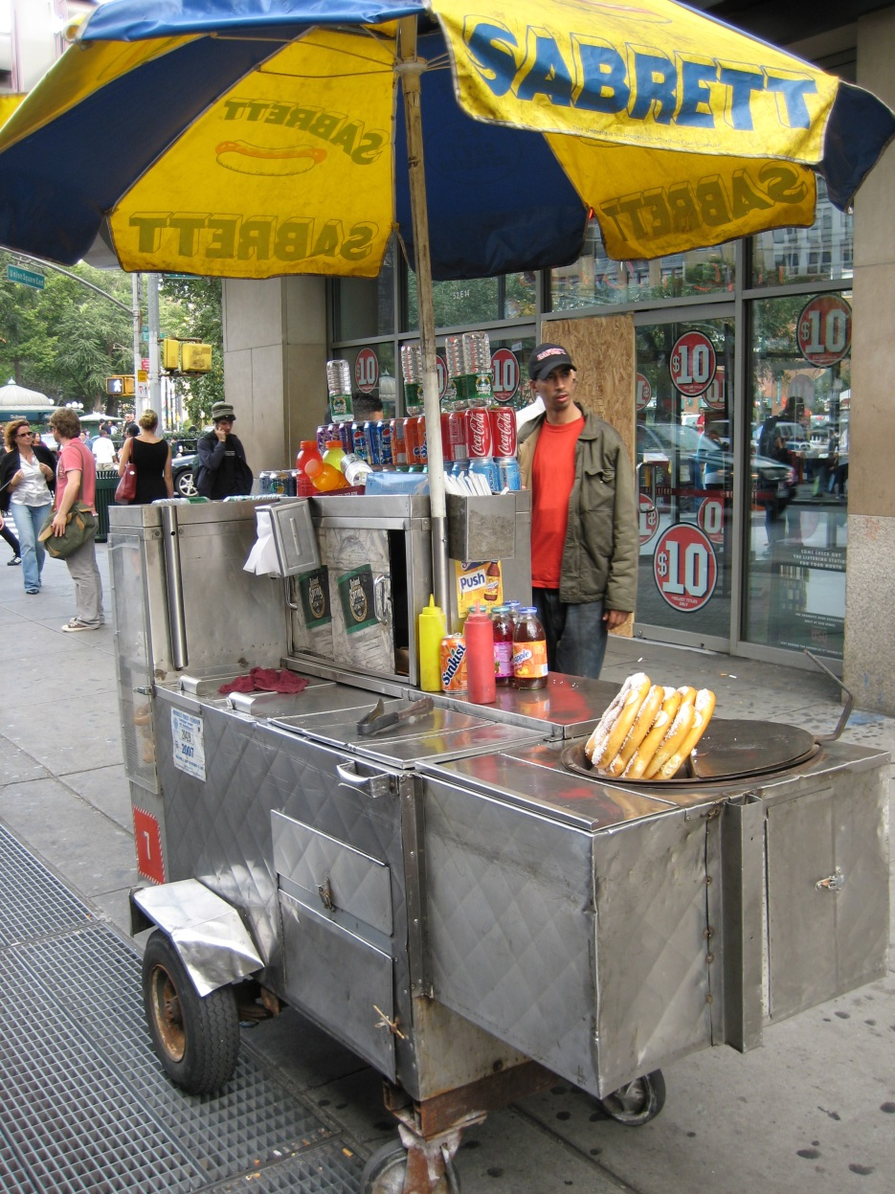
Positioning Bike Share – integrated mobility

Slide 19
Getting Through Start-up
I think bike share is really great as long as its not on my street

Slide 20
Getting Through Start-up
What are some of your concerns about:
Start-up
Station Locations
NIMBYism

Slide 21
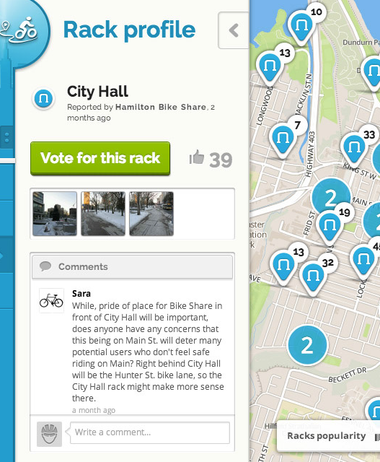
Community engagement is vital

Slide 22
Community engagement is vital

Slide 23
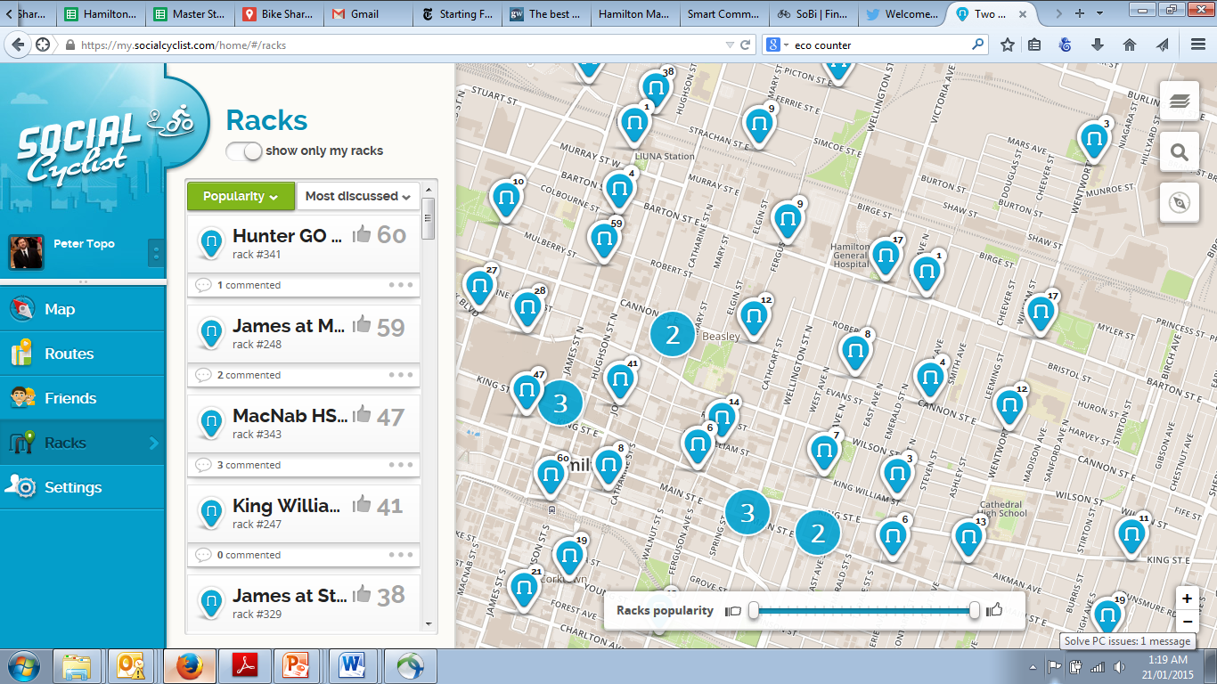
Seize every opportunity for engagement, beyond the engagement period

Slide 24
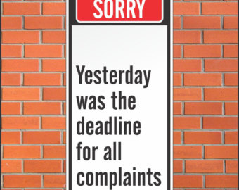
Keep a Complaint Log
⇨ Follow-up with each citizen by email/phone
Perform a site visit where necessary
Explain that this a vital piece of infrastructure
Use their expertise!

Slide 25
Communicate with Residents
Use a letter or door hanger (or both) to raise awareness for stations coming
Offer a discount (even though this may not be fully effective)
Let the Neighborhood Associations and Business Improvement Areas know that stations are coming and residents are being notified

Slide 26
Launch Event
Focus on the positive elements of the project
Have founding members in the lead up to the event
Invite dignitaries and media
Offer free rides and group rides

Slide 27
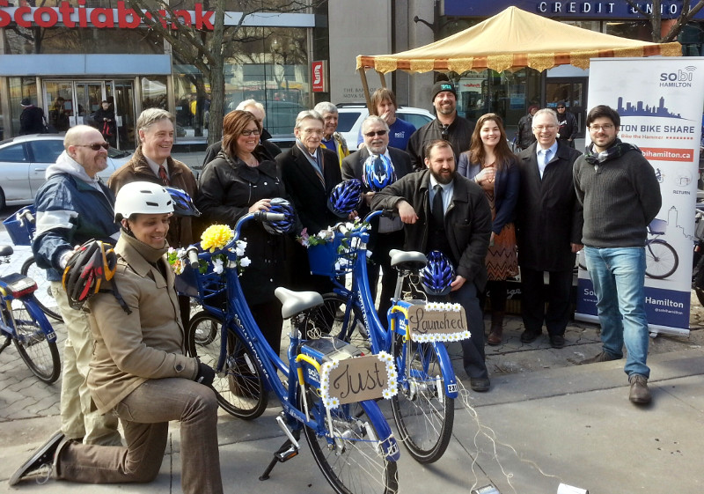
Launch Event

Slide 28
Why isin’t bike share in my neighbourhood? You don’t care about us!

Slide 29
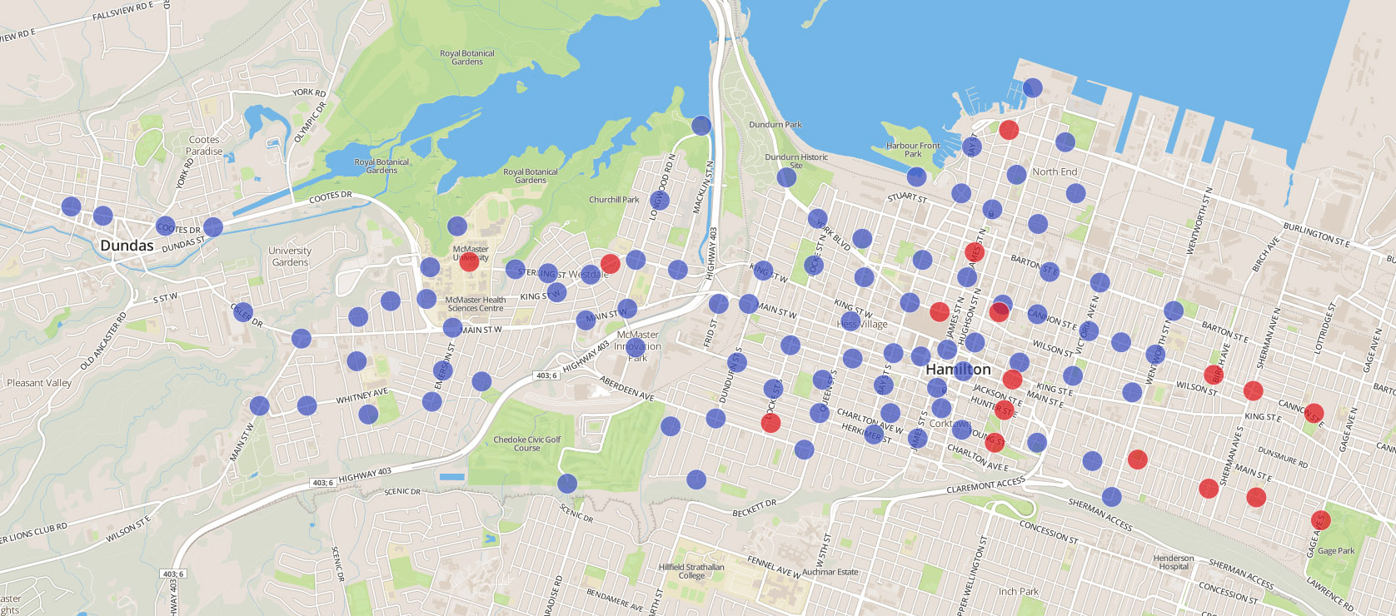
Sure, but who’s going to pay for it?
The need for density and destination!

Slide 30
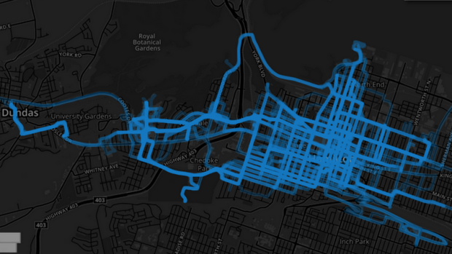
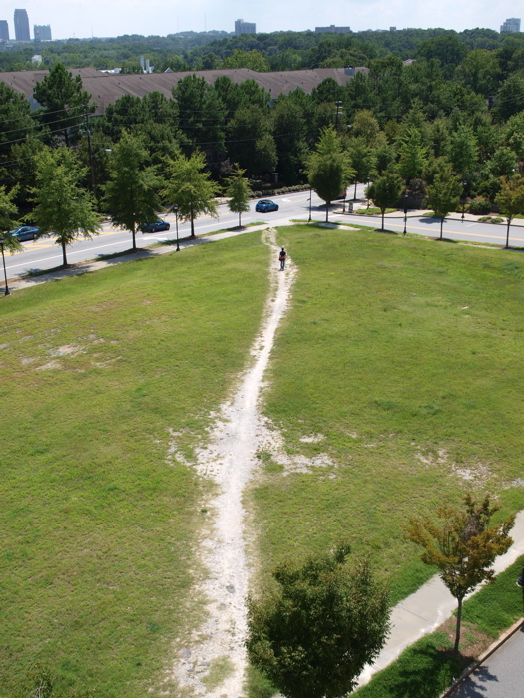
Data-based Engagement Post Launch Station Planning (“Desire Line Analysis”)
Ridership data was used to determine additional stations or station tweaks:
Where people locked outside of a station (no fee charged)
What routes were the most used

Slide 31
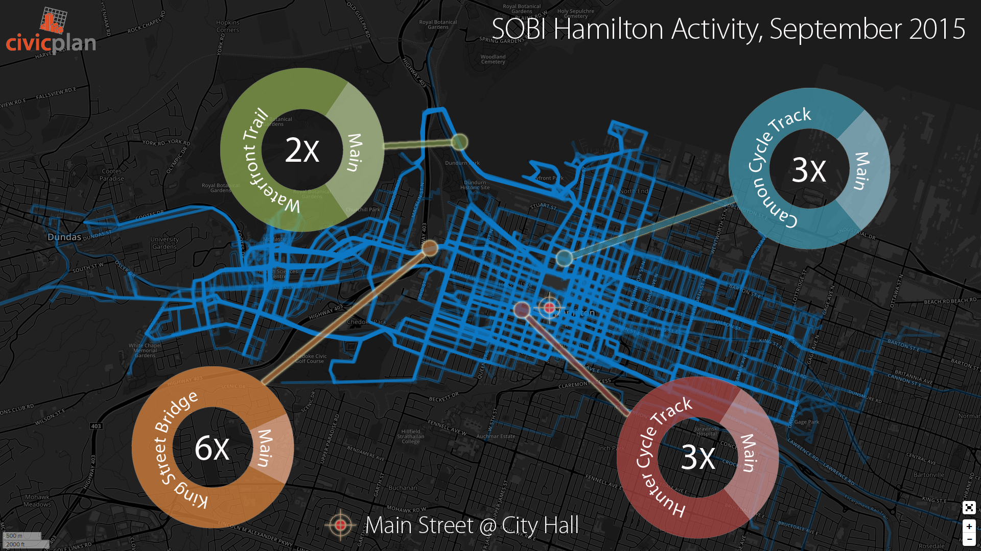
Data-based Engagement - Planning
Data-based Engagement - Planning

Slide 32
Thank-you
Peter Topalovic
Project and Program Manager
Sustainable Mobility Programs
+Bike Share
+Smart Commute
City of Hamilton Public Works
Peter.Topalovic@Hamilton.ca
905-546-2424 x.5129

