Slide 1
Unique Ridership Growth Strategies

Slide 2
The global bike share
Marcelo Loureiro
marcelo@spinlister.com

Slide 4
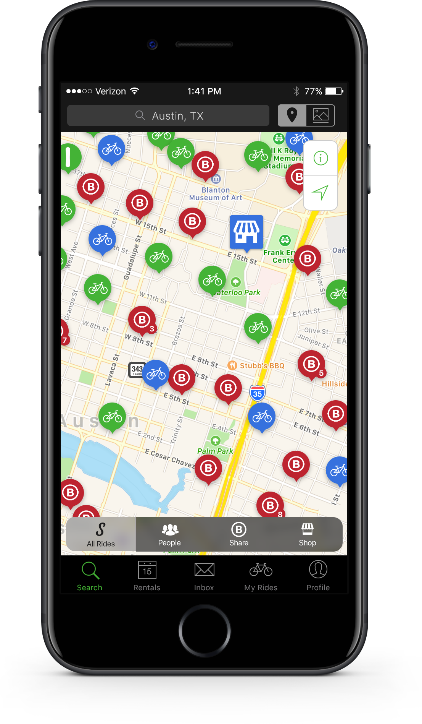
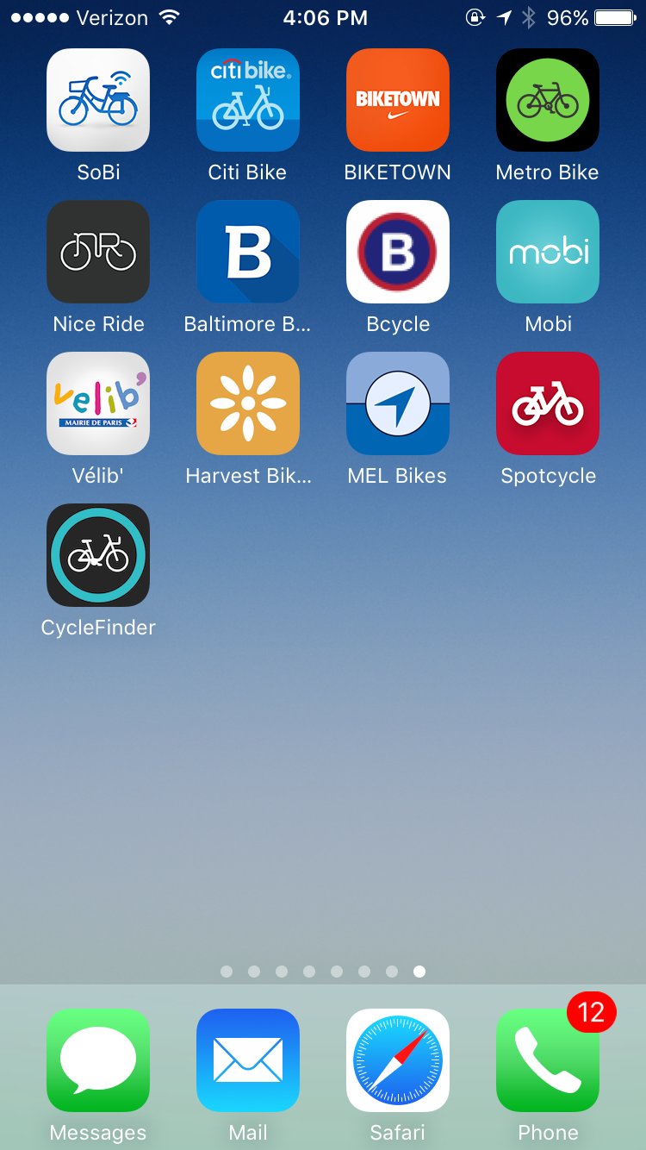
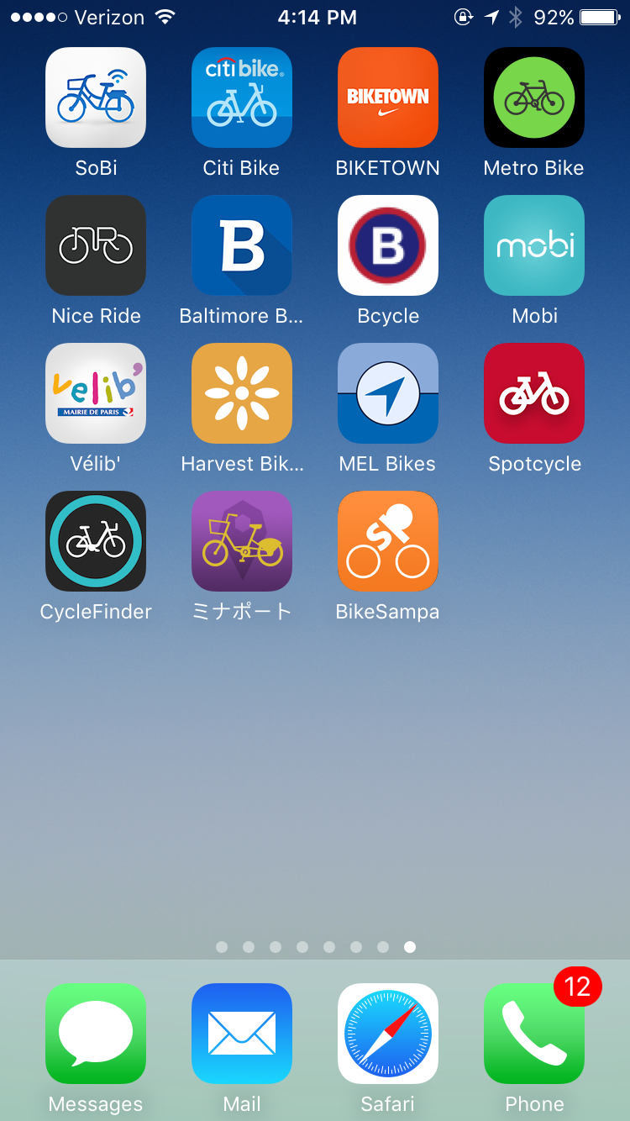

Slide 6
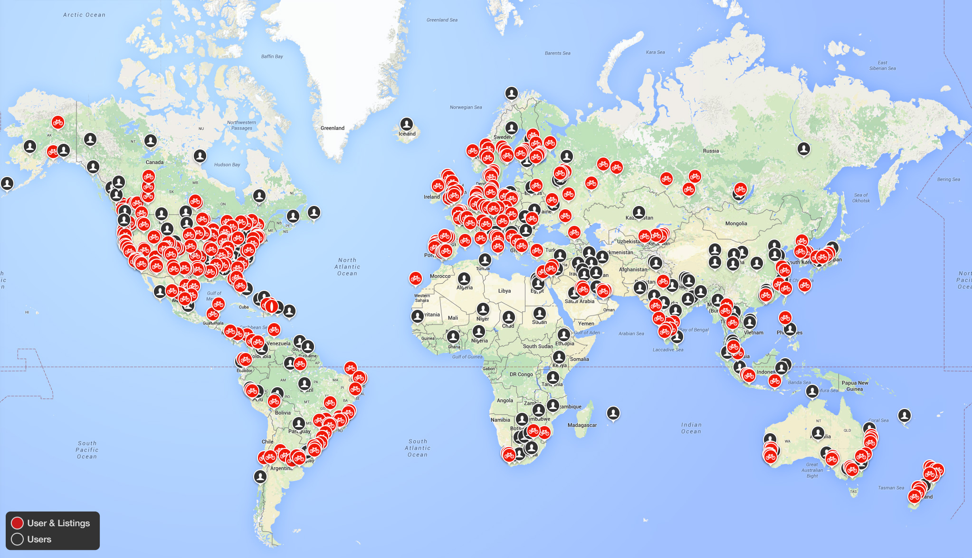
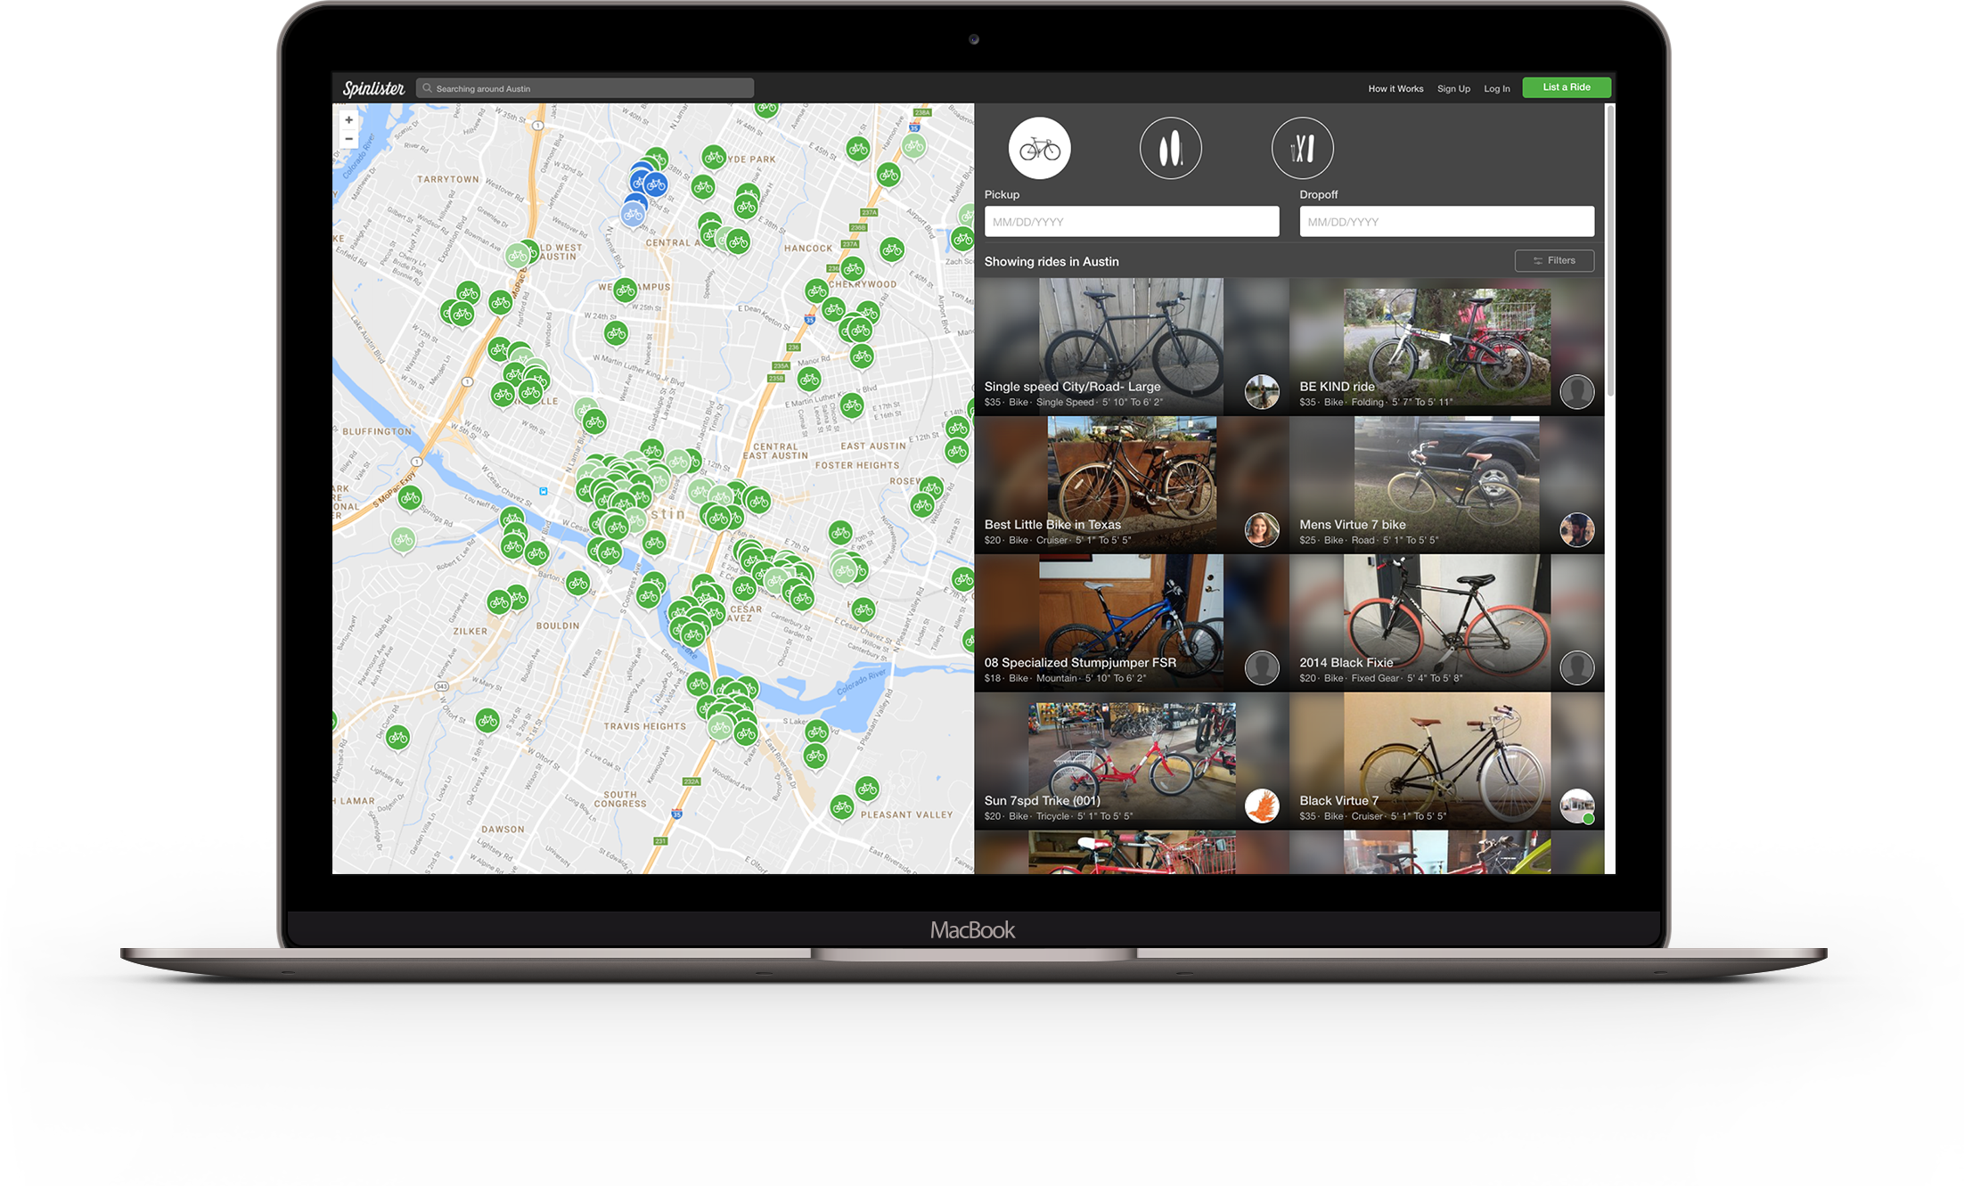

Slide 7
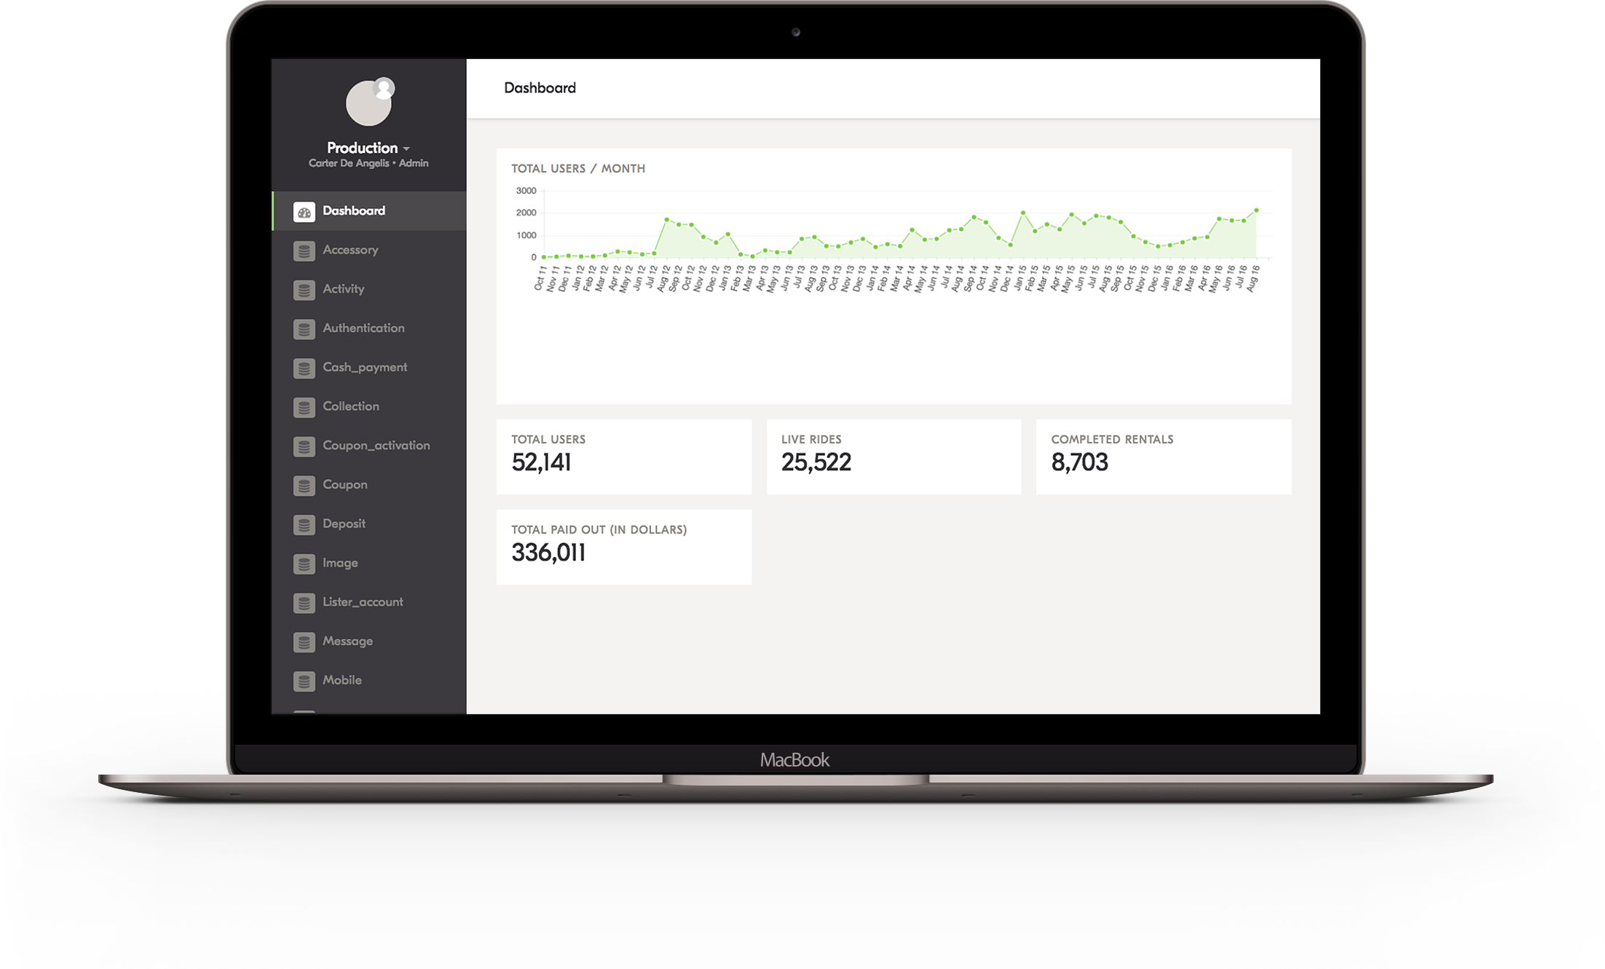

Slide 9
Thank You!
The global bike share
Marcelo Loureiro
marcelo@spinlister.com

